Slide 1
Aakash Goel https://www.linkedin.com/in/goelaakash123/
Session 11:
Attention, Transformers & Vision Transformers (ViT)
Acknowledgement: Slide Materials adopted from - Intro to Computer Vision (Cornell Tech); Noah Snavely, prepared by the lead instructor Prof S P Vimal , modified (added some content) by Aakash Goel

Slide 2
Topics
Attention ( Review)
Transformers ( Review)
Vision Transformer (ViT)
Applications of ViT in Computer Vision
Popular ViT Variants
Acknowledgement: Slide Materials adopted from - Intro to Computer Vision (Cornell Tech); Noah Snavely

Slide 3
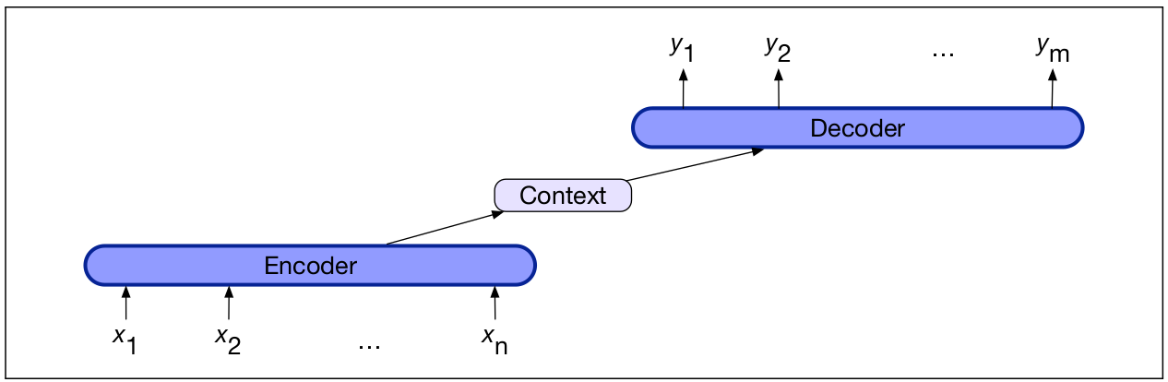
(Review) Encoder - Decoder Arch for Seq. to Seq. Translation
Components:
Encoder
Context Vector, c
Decoder
Note: The context is a function of the hidden representations of the input, and may be used by the decoder in a variety of ways
AIMLCZG525 - Computer Vision
Notes:
This slide is a review of the Encoder-Decoder architecture, which is a fundamental concept in sequence-to-sequence (Seq2Seq) models. These models are widely used in tasks like language translation, where you need to convert a sequence of words in one language to a sequence in another language.
Components:
Encoder:
Think of the encoder as a kind of translator that reads and understands the input sequence. For example, if the input is a sentence in English, the encoder processes each word one by one, from $x_{1}$ to $x_{n}$.
As it reads each word, it builds up an internal understanding or representation of the entire sentence. This is often referred to as the "hidden state."
Context Vector (c):
Once the encoder has processed the entire input sequence, it summarizes all that information into a single vector, known as the context vector.
You can think of this context vector as a compact summary or essence of the input sequence. It captures the meaning of the input in a way that can be used by the decoder.
Decoder:
The decoder's job is to take this context vector and generate the output sequence, one element at a time. For instance, if we're translating from English to French, the decoder will produce the French sentence, starting with $y_{1}$, then $y_{2}$, and so on, until $y_{m}$.
The decoder uses the context vector to ensure that the output sequence is coherent and relevant to the input.
Note:
The context vector is crucial because it acts as a bridge between the input and output sequences. It is derived from the hidden representations of the input and can be used by the decoder in various ways to generate the output.
By understanding this architecture, we can appreciate how Seq2Seq models handle complex tasks like translation by breaking them down into understandable steps: encoding the input, summarizing it, and then decoding it into the desired output. This sets the stage for understanding more advanced concepts like attention and transformers, which build upon this foundational idea.

Slide 4
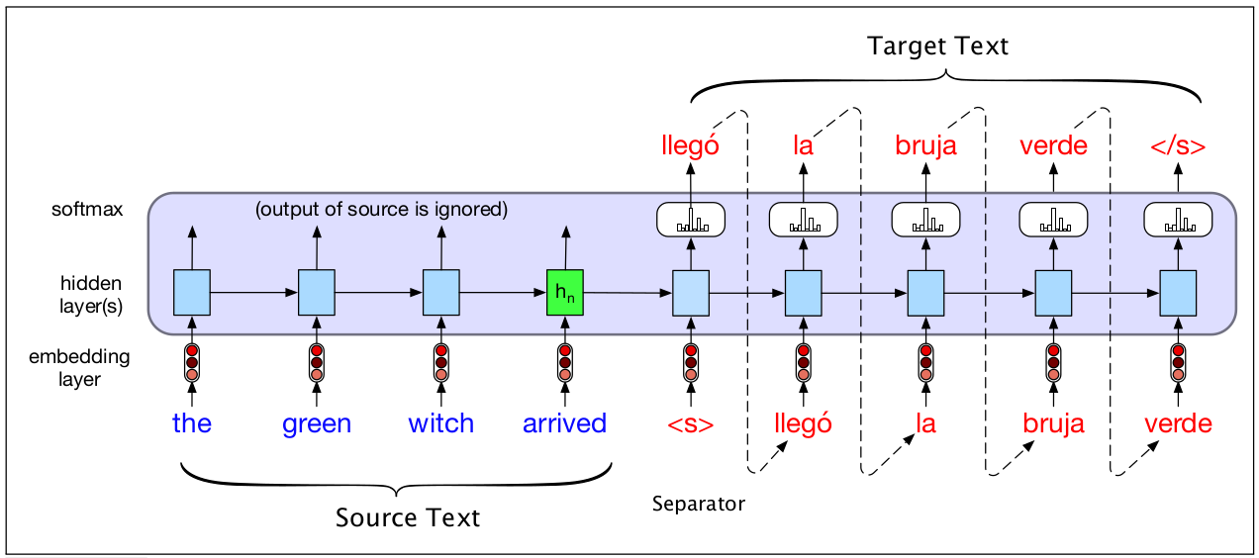
(Review) Encoder - Decoder Arch for Seq. to Seq. Translation
We make the context vector c available to more than just the first decoder hidden state, to ensure that the influence of the context vector, c, doesn’t wane as the output sequence is generated.
Notes:
In this slide, we see a practical example of how the Encoder-Decoder architecture processes a sequence of words from a source language (English) and translates it into a target language (Spanish).
Process Breakdown:
Source Text Encoding:
The input sentence "the green witch arrived" is processed word by word by the encoder.
Each word is first converted into a numerical representation through an embedding layer, which helps the model understand the semantic meaning of the words.
These embeddings are then passed through a series of hidden layers, which build up the internal representation of the sentence. This is shown by the sequence of blue boxes.
The final hidden state, $h_{n}$, captures the essence of the entire input sentence. This is the context vector we discussed earlier.
Context Vector:
The context vector $h_{n}$ is crucial because it contains all the information the decoder needs to start generating the target text.
Unlike simpler models, this architecture makes the context vector available to more than just the first decoder hidden state. This ensures that the influence of the context vector doesn't diminish as the output sequence is generated.
Target Text Decoding:
The decoder begins with a special start token <s>, which signals the beginning of the output sequence.
Using the context vector and the start token, the decoder generates the first word of the target sentence, "llegó".
This process continues, with each generated word being fed back into the decoder to help generate the next word, until the entire sentence "llegó la bruja verde" is produced.
The process ends with a special end token </s>, indicating the completion of the translation.
Key Insight:
By making the context vector available throughout the decoding process, the model maintains a strong connection to the original input, ensuring that the translation remains accurate and contextually relevant.
This slide illustrates how the Encoder-Decoder architecture effectively handles the translation task by maintaining a continuous flow of information from the input to the output, ensuring that the generated text is both coherent and faithful to the source. This sets the stage for understanding how attention mechanisms can further enhance this process by allowing the model to focus on specific parts of the input when generating each word of the output.

Slide 5
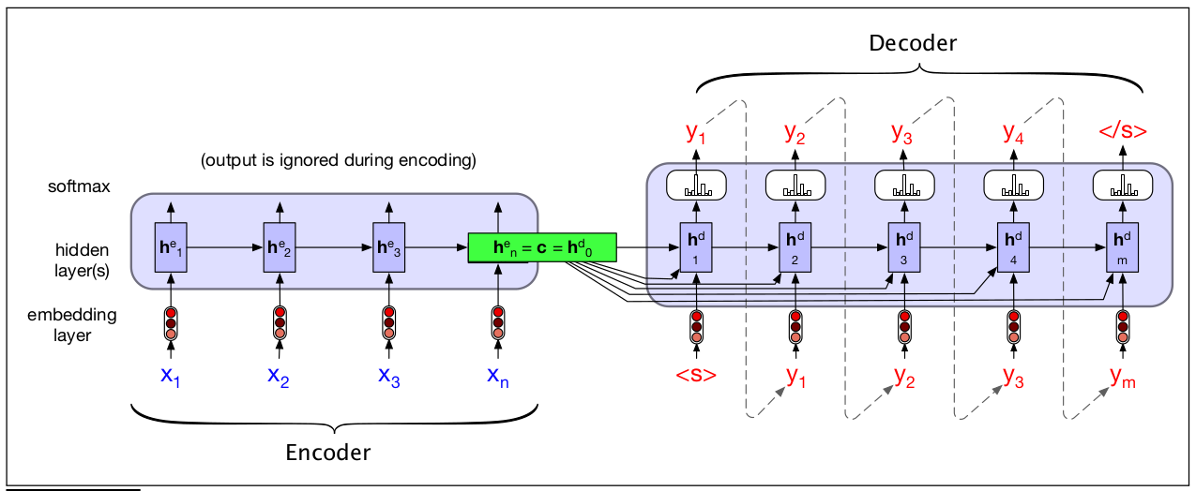
(Review) Encoder - Decoder Arch for Seq. to Seq. Translation
Source and target sentences are concatenated with a separator token in between, and the decoder uses context information from the encoder’s last hidden state.
Notes:
In this diagram, we see a more abstract representation of the Encoder-Decoder process, highlighting the role of the context vector and the sequence of operations involved in translating from a source to a target sequence.
Key Elements:
Encoder:
The encoder processes the input sequence $x_{1},x_{2},…,x_{n}$ through an embedding layer and several hidden layers, similar to what we saw in the previous slide.
Each word in the input sequence is transformed into a hidden state, with the final hidden state $h_{n}$ being particularly important. This final state is often referred to as the context vector $c$.
Context Vector:
The context vector $c$ is derived from the last hidden state of the encoder, $h_{n}$, and is crucial for the decoder's operation.
This vector acts as a summary of the entire input sequence, capturing its essential information and meaning.
Decoder:
The decoder starts with a special start token <s>, which signals the beginning of the output sequence.
It uses the context vector $c$ to initialize its first hidden state $h_{0}^{d}$, ensuring that the output generation is informed by the input sequence.
The decoder then generates each word of the target sequence $y_{1},y_{2},…,y_{m}$ one by one, using its own hidden states and the context vector to maintain coherence and relevance to the input.
The process concludes with a special end token </s>, indicating the end of the output sequence.
Additional Insight:
The note at the bottom of the slide mentions that source and target sentences are concatenated with a separator token. This is a technique used in some models to clearly delineate the input and output sequences, ensuring that the model understands where one ends and the other begins.
The decoder's reliance on the context vector from the encoder's last hidden state highlights the importance of this vector in maintaining the connection between the input and output sequences.

Slide 6
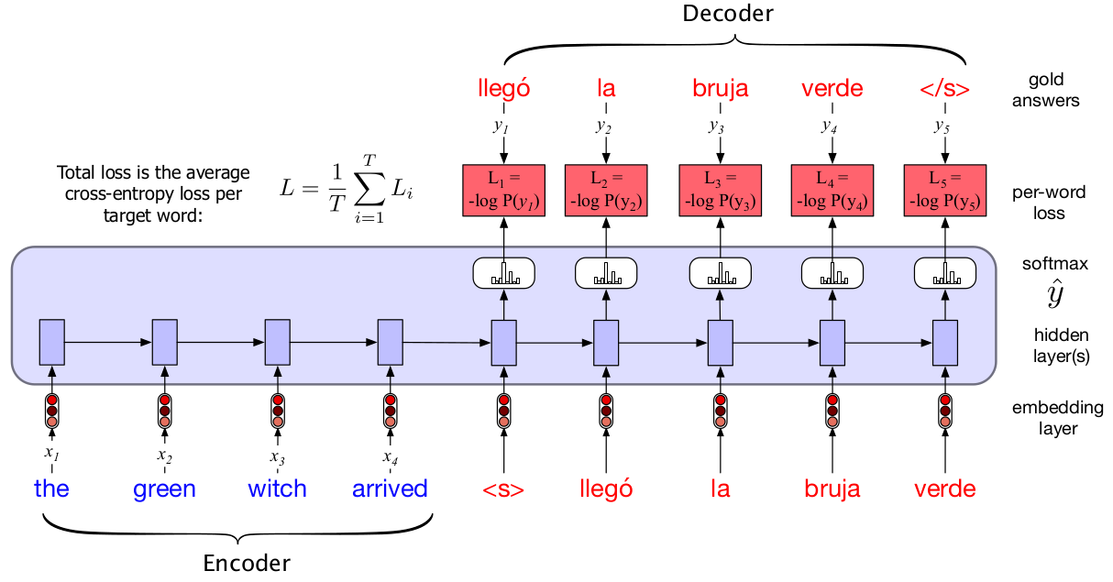
(Review) Encoder - Decoder Arch for Seq. to Seq. Translation
In the decoder we usually don’t propagate the model’s softmax outputs ŷt , but use teacher forcing. We compute the softmax output distribution over ŷ in the decoder, which can then be averaged to compute a loss for the sentence.
Notes:
In this slide, we see how the Encoder-Decoder architecture is trained to improve its translation accuracy by comparing its predictions to the correct target sequence.
Training Process:
Encoder:
The encoder processes the input sequence "the green witch arrived" as before, generating a context vector that summarizes the input.
Decoder with Teacher Forcing:
During training, instead of using the decoder's own predictions to generate the next word, we use the actual target words (gold answers) from the training data. This is known as "teacher forcing."
For example, after generating "llegó," instead of using the model's prediction for the next word, we feed the correct next word "la" into the decoder.
Softmax and Loss Calculation:
The decoder outputs a probability distribution over possible words for each position in the target sequence using a softmax layer.
The predicted word ${\hat{y}}_{t}$ is compared to the actual word $y_{t}$ using a loss function. Here, the cross-entropy loss is used, which measures how well the predicted probability distribution matches the true distribution.
For each word, the loss is calculated as $−\log{P}\left(y_{t}\right)$, where $P\left(y_{t}\right)$ is the probability assigned to the correct word by the model.
Total Loss:
The total loss for the sequence is the average of the per-word losses. This loss is used to update the model's parameters, helping it learn to make better predictions.
Key Insight:
Teacher forcing helps the model learn more effectively by providing it with the correct context at each step, rather than relying on its potentially incorrect predictions.
The loss function provides a quantitative measure of how well the model is performing, guiding the training process to minimize errors.
This slide highlights the importance of teacher forcing in training Seq2Seq models, ensuring that they learn from the correct sequences and improve their translation capabilities. Understanding this process is crucial for appreciating how models are optimized and how techniques like attention can further enhance their performance by allowing them to focus on relevant parts of the input during decoding.

Slide 7
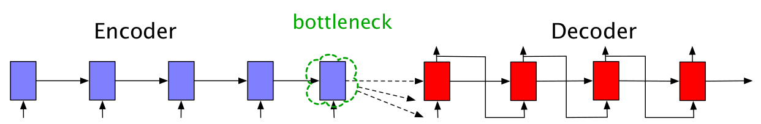
(Review) Encoder - Decoder Arch for Seq. to Seq. Translation
Requiring the context c to be only the encoder’s final hidden state forces all the information from the entire source sentence to pass through this representational bottleneck.
Notes:
In the traditional Encoder-Decoder architecture, the context vector acts as a bottleneck, which can limit the model's ability to effectively translate complex or lengthy sequences.
Understanding the Bottleneck:
Encoder:
The encoder processes the input sequence and compresses all the information into a single context vector, represented by the final hidden state.
Bottleneck:
This context vector is the only source of information for the decoder. It must encapsulate the entire meaning of the input sequence.
The term "bottleneck" is used because this single vector can become a limiting factor. It forces all the rich and detailed information from the input to be squeezed into a compact form, which can lead to loss of important details, especially for long or complex sentences.
Decoder:
The decoder relies solely on this context vector to generate the output sequence. If the context vector is not sufficiently informative, the quality of the translation can suffer.
Key Insight:
The bottleneck problem highlights a fundamental challenge in the traditional Encoder-Decoder setup: the difficulty of capturing all necessary information in a single vector.
This limitation is particularly pronounced in tasks involving long sequences, where the context vector may not adequately represent all the nuances of the input.
This slide sets the stage for introducing attention mechanisms, which address the bottleneck issue by allowing the model to dynamically focus on different parts of the input sequence during decoding. Attention provides a way to bypass the bottleneck by enabling the decoder to access the full range of encoder states, thereby improving the model's ability to handle complex translations. Understanding this limitation helps appreciate the advancements brought by attention and transformers in sequence-to-sequence tasks.

Slide 8
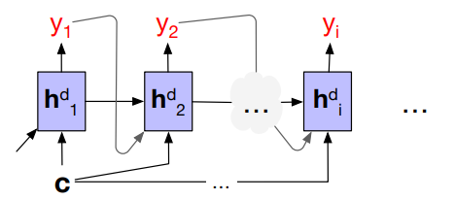
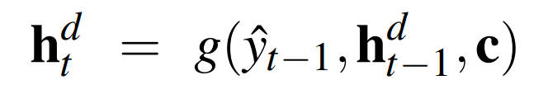
(Review) Attention !
Without attention, a decoder sees the same context vector , which is a static function of all the encoder hidden states
Notes:
Attention mechanisms enhance the Seq2Seq model by providing a more flexible and dynamic way to use the information from the encoder, rather than relying solely on a static context vector.
Key Concepts:
Static Context Vector:
In the traditional setup without attention, the decoder uses the same static context vector $c$ for generating each word in the output sequence.
This vector is a fixed summary of all the encoder's hidden states, which can limit the model's ability to capture detailed information, especially for long sequences.
Attention Mechanism:
Attention allows the decoder to access different parts of the encoder's hidden states dynamically, rather than relying on a single static vector.
For each output word $y_{i}$, the decoder can focus on different parts of the input sequence, effectively creating a context that is tailored to the specific word being generated.
Decoder State Update:
The equation $h_{t}^{d}=g\left({\hat{y}}_{t−1} , h_{t−1}^{d} , c\right)$ represents how the decoder's hidden state is updated at each time step.
Here, $g$ is a function that combines the previous output ${\hat{y}}_{t−1}$, the previous hidden state $h_{t−1}^{d}$, and the context vector $c$ to produce the current hidden state $h_{t}^{d}$.
With attention, the context vector $c$ can be dynamically adjusted for each time step, allowing the model to focus on the most relevant parts of the input sequence.
Key Insight:
Attention mechanisms provide a way to overcome the bottleneck problem by allowing the decoder to access a richer set of information from the encoder.
This dynamic focus improves the model's ability to generate accurate and contextually relevant translations, especially for complex or lengthy sequences.
This slide sets the foundation for understanding how attention mechanisms revolutionize Seq2Seq models by enabling them to handle more complex tasks with greater accuracy. It paves the way for exploring more advanced architectures like Transformers, which rely heavily on attention to achieve state-of-the-art performance in various natural language processing tasks.

Slide 9
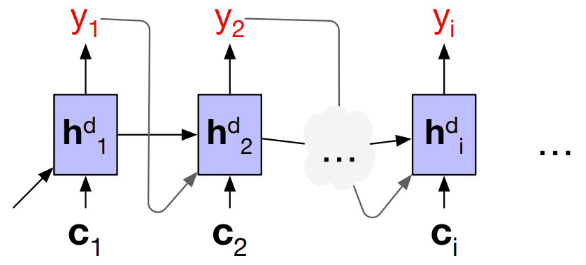
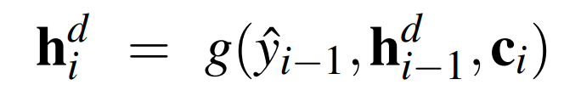
(Review) Attention !
He went to the bank to find his bank account was empty and then he went to the river bank and cried
Without attention, a decoder sees the same context vector , which is a static function of all the encoder hidden states
With attention, decoder to sees a different, dynamic, context, which is a function of all the encoder hidden states
Notes:
The slide contrasts two scenarios: one without attention and one with attention, using a sentence with potential ambiguity to demonstrate the benefits of attention.
Without Attention:
Static Context Vector:
The decoder uses the same static context vector $c$ for generating each word in the output sequence.
This approach can struggle with sentences that have ambiguous or context-dependent meanings, as it cannot dynamically adjust its focus based on the specific word being generated.
Example Sentence:
Consider the sentence: "He went to the bank to find his bank account was empty and then he went to the river bank and cried."
Without attention, the model might have difficulty distinguishing between the two meanings of "bank" (financial institution vs. riverbank) because it relies on a single, unchanging context vector.
With Attention:
Dynamic Context Vector:
With attention, the decoder can use a different context vector $c_{i}$ for each word $y_{i}$, allowing it to focus on the most relevant parts of the input sequence.
This dynamic adjustment helps the model resolve ambiguities and generate more accurate translations.
Example Sentence:
In the same sentence, attention allows the model to focus on the appropriate parts of the input when generating each word. For instance, when generating the word "bank" in the context of "river bank," the model can focus on the surrounding words that indicate the geographical meaning.
Decoder State Update:
The equation $h_{i}^{d}=g\left({\hat{y}}_{i−1} , h_{i−1}^{d} , c_{i}\right)$ shows how the decoder's hidden state is updated using a dynamic context vector $c_{i}$, which is tailored to each word being generated.
Key Insight:
Attention mechanisms enable the model to dynamically adjust its focus, improving its ability to handle complex sentences with multiple meanings or dependencies.
This flexibility is crucial for generating accurate and contextually appropriate translations, especially in languages with rich semantic structures.
This slide effectively demonstrates how attention mechanisms enhance the Seq2Seq model's capabilities by allowing it to dynamically focus on relevant parts of the input sequence. This sets the stage for understanding how transformers, which rely heavily on attention, achieve state-of-the-art performance in various natural language processing tasks.

Slide 10
(Review) Attention !
Without attention, a decoder sees the same context vector , which is a static function of all the encoder hidden states
With attention, decoder to sees a different, dynamic, context, which is a function of all the encoder hidden states
With attention, decoder gets information from all the hidden states of the encoder, not just the last hidden state of the encoder
Each context vector is obtained by taking a weighted sum of all the encoder hidden states.
The weights focus on (‘attend to’) a particular part of the source text that is relevant for the token the decoder is currently producing
Notes:
Slide Explanation:
The slide contrasts the traditional static context approach with the dynamic context provided by attention, emphasizing how attention improves the model's ability to generate accurate translations.
Without Attention:
Static Context Vector:
The decoder uses a single, static context vector $c$ for generating each word in the output sequence.
This vector is a fixed summary of all the encoder's hidden states, which can limit the model's ability to capture detailed information.
Decoder State Update:
The equation $h_{t}^{d}=g\left({\hat{y}}_{t−1} , h_{t−1}^{d} , c\right)$ shows how the decoder's hidden state is updated using this static context vector.
With Attention:
Dynamic Context Vector:
With attention, the decoder uses a different context vector $c_{i}$ for each word $y_{i}$, allowing it to focus on the most relevant parts of the input sequence.
Each context vector is obtained by taking a weighted sum of all the encoder's hidden states. This means the model can dynamically adjust its focus based on the specific word being generated.
Attention Weights:
The weights determine how much attention is paid to each part of the input sequence. They are calculated based on the relevance of each encoder hidden state to the current decoding step.
These weights allow the model to "attend to" specific parts of the source text that are most relevant for generating the current output token.
Decoder State Update:
The equation $h_{i}^{d}=g\left({\hat{y}}_{i−1} , h_{i−1}^{d} , c_{i}\right)$ illustrates how the decoder's hidden state is updated using the dynamic context vector $c_{i}$, which is tailored to each word being generated.
Key Insight:
Attention mechanisms enable the model to dynamically adjust its focus, improving its ability to handle complex sentences with multiple meanings or dependencies.
By using a weighted sum of encoder hidden states, the model can create a context that is specific to each output word, enhancing translation accuracy and contextual relevance.
This slide effectively demonstrates how attention mechanisms enhance the Seq2Seq model's capabilities by allowing it to dynamically focus on relevant parts of the input sequence. This understanding is crucial for appreciating how transformers, which rely heavily on attention, achieve state-of-the-art performance in various natural language processing tasks.

Slide 11


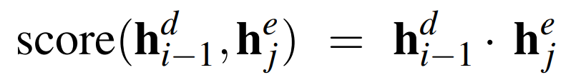
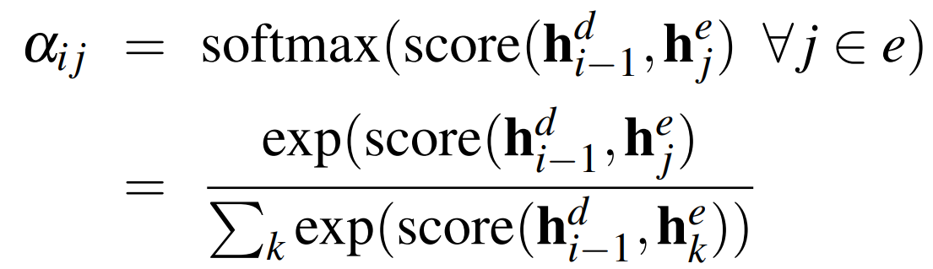
(Review) Attention !
Step -1 :
Find out how relevant each encoder state is to the present decoder state
Compute a score of similarity between and all the encoder states :
Dot Product Attention :
Step -2 :
Normalize all the scores with softmax to create a vector of weights, α_{i,j}
α_{i,j} indicates the proportional relevance of each encoder hidden state j to the prior hidden decoder state,
Notes:
The attention mechanism involves calculating scores and weights to determine the relevance of each encoder hidden state to the current decoding step.
Step 1: Calculate Relevance Scores
Objective: Determine how relevant each encoder hidden state $h_{j}^{e}$ is to the current decoder hidden state $h_{i−1}^{d}$.
Score Calculation:
The score is a measure of similarity between the decoder's previous hidden state and each encoder hidden state.
Dot Product Attention: This is a common method for calculating the score, where the score is the dot product of $h_{i−1}^{d}$ and $h_{j}^{e}$. Mathematically, it's expressed as: $$\text{score}\left(h_{i−1}^{d} , h_{j}^{e}\right)=h_{i−1}^{d}⋅h_{j}^{e}$$
The dot product effectively measures how aligned or similar the two vectors are, indicating how much attention should be paid to each encoder state.
Step 2: Normalize Scores to Get Weights
Objective: Convert the raw scores into a set of weights that sum to 1, indicating the relative importance of each encoder hidden state.
Softmax Normalization:
The scores are passed through a softmax function to produce a vector of attention weights $α_{i,j}$.
The softmax function ensures that the weights are positive and sum to 1, making them interpretable as probabilities.
Mathematically, the weight for each encoder state is calculated as:
These weights indicate the proportional relevance of each encoder hidden state to the current decoder state.
Key Insight:
By calculating and normalizing these scores, the attention mechanism allows the model to dynamically focus on the most relevant parts of the input sequence for each word it generates.
This process enhances the model's ability to handle complex dependencies and contextual nuances in the input data.
This slide provides a clear and detailed explanation of how attention mechanisms work, setting the foundation for understanding more advanced models like transformers, which use attention extensively to achieve superior performance in various tasks.

Slide 12
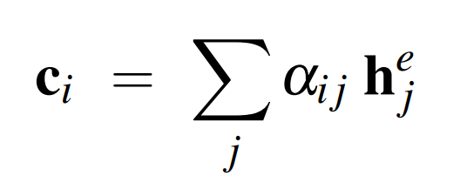
(Review) Attention !
Step -3 :
Given the distribution in α, compute a fixed-length context vector for the current decoder state by taking a weighted average over all the encoder hidden states
Notes:
Step 3: Compute the Context Vector
Objective: Use the attention weights calculated in the previous step to create a context vector $c_{i}$ that is specific to the current decoder state.
Weighted Average:
The context vector $c_{i}$ is computed as a weighted sum of all the encoder hidden states $h_{j}^{e}$.
Each encoder hidden state is multiplied by its corresponding attention weight $α_{i,j}$, which indicates its relevance to the current decoding step.
Mathematically, the context vector is expressed as: $$c_{i}=\sum_{j}{α_{i,j}}h_{j}^{e}$$
This operation effectively combines the encoder hidden states into a single vector that captures the most relevant information for generating the current output word.
Key Insight:
The context vector $c_{i}$ is dynamic and changes for each word being generated, allowing the model to focus on different parts of the input sequence as needed.
This dynamic adjustment helps the model handle complex dependencies and contextual nuances, improving the quality and accuracy of the generated output.
By completing this step, the attention mechanism provides the decoder with a tailored context for each word it generates, enhancing the model's ability to produce coherent and contextually appropriate translations. This understanding is essential for appreciating how attention mechanisms contribute to the success of advanced models like transformers, which leverage attention to achieve state-of-the-art performance in various tasks.

Slide 13
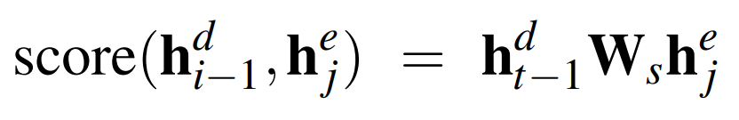
(Review) Attention !
Step -3 :
Given the distribution in α, compute a fixed-length context vector for the current decoder state by taking a weighted average over all the encoder hidden states
Plus :
In step-1, we can get a more powerful scoring function by parameterizing the score with its own set of weights, W_{s}:
W_{s} , is trained during normal end-to-end training,
W_{s} , gives the network the ability to learn which aspects of similarity between the decoder and encoder states are important to the current application.
Notes:
Step 3 Recap: Compute the Context Vector
The context vector $c_{i}$ is computed as a weighted average of the encoder hidden states, using the attention weights $α_{i,j}$ to focus on the most relevant parts of the input sequence for the current decoder state.
Enhancement: Parameterized Scoring Function
Objective: Improve the scoring function used in Step 1 to better capture the relevance of each encoder hidden state to the current decoder state.
Parameterized Score:
Instead of using a simple dot product, the score can be parameterized with a learnable weight matrix $W_{s}$.
The new scoring function is expressed as: $$\text{score}\left(h_{i−1}^{d} , h_{j}^{e}\right)=h_{i−1}^{d}W_{s}h_{j}^{e}$$
Here, $W_{s}$ is a matrix of weights that is learned during the model's training process.
Benefits:
By introducing $W_{s}$, the model gains the ability to learn which aspects of similarity between the decoder and encoder states are most important for the task at hand.
This makes the attention mechanism more flexible and powerful, as it can adapt to different applications and data characteristics.
Key Insight:
Parameterizing the scoring function allows the model to learn more nuanced relationships between the encoder and decoder states, improving its ability to focus on the most relevant parts of the input sequence.
This enhancement can lead to better performance, especially in complex tasks where simple similarity measures may not capture all the necessary information.
This slide highlights how attention mechanisms can be further refined by introducing learnable parameters, enhancing the model's ability to generate accurate and contextually appropriate outputs. This understanding is crucial for appreciating the advancements in models like transformers, which leverage sophisticated attention mechanisms to achieve state-of-the-art results in various natural language processing tasks.

Slide 14
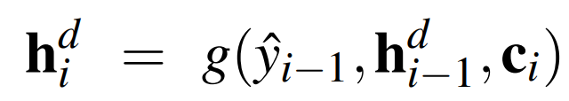
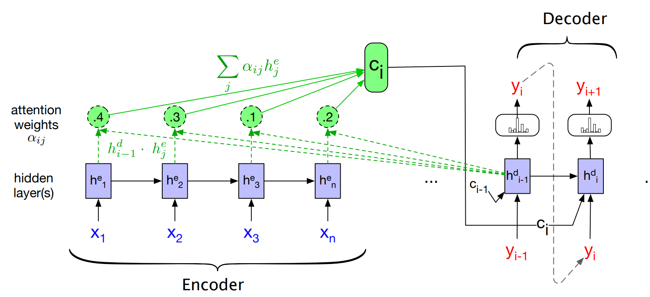
(Review) Attention !
Notes:
Slide Explanation:
The diagram shows the flow of information from the encoder to the decoder, highlighting how attention weights are used to compute a dynamic context vector for each decoding step.
Encoder:
The encoder processes the input sequence $x_{1},x_{2},…,x_{n}$ and generates a series of hidden states $h_{1}^{e},h_{2}^{e},…,h_{n}^{e}$.
These hidden states capture the information from the input sequence and are used by the attention mechanism to create context vectors.
Attention Weights:
Attention weights $α_{ij}$ are calculated for each encoder hidden state $h_{j}^{e}$ with respect to the current decoder state $h_{i−1}^{d}$.
These weights indicate the relevance of each encoder hidden state to the current decoding step.
In the diagram, example weights are shown as 0.4, 0.3, 0.1, and 0.2, representing the focus on different parts of the input sequence.
Context Vector $c_{i}$:
The context vector $c_{i}$ is computed as a weighted sum of the encoder hidden states, using the attention weights: $$c_{i}=\sum_{j}{α_{ij}}h_{j}^{e}$$
This vector provides the decoder with a tailored summary of the input sequence, focusing on the most relevant information for generating the current output word.
Decoder:
The decoder uses the context vector $c_{i}$, along with its previous hidden state $h_{i−1}^{d}$ and the previously generated word ${\hat{y}}_{i−1}$, to compute the current hidden state $h_{i}^{d}$: $$h_{i}^{d}=g\left({\hat{y}}_{i−1} , h_{i−1}^{d} , c_{i}\right)$$
This process allows the decoder to generate the next word $y_{i}$ in the output sequence, informed by the dynamically computed context.
Key Insight:
The attention mechanism enables the model to dynamically focus on different parts of the input sequence for each word it generates, improving its ability to handle complex dependencies and contextual nuances.
This dynamic focus is crucial for generating accurate and contextually appropriate translations, especially in tasks involving long or complex sequences.
This slide effectively illustrates the inner workings of the attention mechanism, providing a clear understanding of how it enhances the Seq2Seq model's capabilities. This understanding is foundational for appreciating the advancements in models like transformers, which leverage attention to achieve state-of-the-art performance in various natural language processing tasks.

Slide 15
(Review) Transformers
2017, NIPS, Vaswani et. al., Attention Is All You Need !!!
Transformers map sequences of input vectors (x₁,...,x_{n}) to sequences of output vectors (y₁,...,y_{n}) of the same length
Made up of transformer blocks in which the key component is self-attention layers
[ Self-attention allows a network to directly extract and use information from arbitrarily large contexts directly !!! ]
Transformers are not based on recurrent connections ⇒ Parallel implementations possible ⇒ Efficient to scale ( comparing LSTM)
Notes:
Key Points about Transformers:
Introduction and Impact:
The transformer model was introduced in 2017 at the NIPS conference by Vaswani et al. in the paper titled "Attention Is All You Need."
This model has significantly influenced the field of NLP and beyond, setting new standards for performance and efficiency.
Mapping Sequences:
Transformers map sequences of input vectors $\left(x_{1} , … , x_{n}\right)$ to sequences of output vectors $\left(y_{1} , … , y_{n}\right)$ of the same length.
This mapping is achieved through a series of transformations that involve attention mechanisms.
Transformer Blocks and Self-Attention:
The architecture is composed of multiple transformer blocks, with self-attention layers being a key component.
Self-Attention: This mechanism allows the model to consider the entire input sequence when processing each element, enabling it to capture dependencies and relationships across the sequence.
Self-attention provides the ability to directly extract and use information from arbitrarily large contexts, which is crucial for understanding complex sequences.
Efficiency and Scalability:
Unlike traditional models like LSTMs, transformers are not based on recurrent connections. This design choice allows for parallel processing of input sequences.
The lack of recurrence makes transformers highly efficient and scalable, as they can leverage parallel computation to process sequences more quickly and effectively.
Key Insight:
The introduction of transformers marked a paradigm shift in sequence processing, offering a more efficient and powerful alternative to recurrent models.
By focusing on attention mechanisms, transformers can handle long-range dependencies and complex relationships within sequences, leading to superior performance in a wide range of tasks.
This slide highlights the transformative impact of the transformer architecture, setting the stage for understanding how it has become the foundation for many state-of-the-art models in NLP, such as BERT, GPT, and others. The efficiency and effectiveness of transformers have made them a cornerstone of modern AI research and applications.

Slide 16
(Review) Self-Attention | Transformers
Attention ⇒ Ability to compare an item of interest to a collection of other items in a way that reveals their relevance in the current context.
Self-attention ⇒
> Set of comparisons are to other elements within a given sequence
> Use these comparisons to compute an output for the current input
Notes:
Attention:
General Concept:
Attention refers to the ability of a model to compare an item of interest to a collection of other items, determining their relevance in the current context.
This mechanism allows the model to focus on the most important parts of the input when making predictions or generating outputs.
Self-Attention:
Specific to Transformers:
Self-attention is a specific type of attention where the set of comparisons is made within a given sequence.
Each element in the sequence is compared to every other element, allowing the model to understand the relationships and dependencies between them.
Process:
Comparisons: For each element in the sequence, the model computes a set of comparisons to all other elements. This involves calculating attention scores that indicate the relevance of each element to the current one.
Output Computation: These comparisons are used to compute an output for the current input element. The output is a weighted sum of the other elements, where the weights are determined by the attention scores.
Key Insight:
Self-attention enables the model to capture long-range dependencies and contextual information within a sequence, which is crucial for understanding complex data.
By allowing each element to attend to every other element, self-attention provides a flexible and powerful way to process sequences, making it a key component of the transformer architecture.
This slide highlights the importance of self-attention in transformers, explaining how it allows the model to dynamically focus on relevant parts of the input sequence. This understanding is foundational for appreciating how transformers achieve state-of-the-art performance in various natural language processing tasks by effectively modeling complex dependencies and relationships.

Slide 17
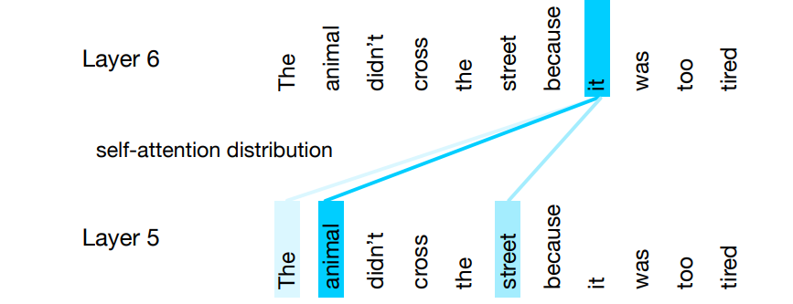
(Review) Self-Attention | Transformers
Notes:
Self-Attention in Action:
The diagram shows a sentence: "The animal didn't cross the street because it was too tired."
The focus is on the word "it" in the sentence, and the self-attention mechanism is used to determine which other words in the sentence are most relevant to "it."
Attention Distribution:
Layer 5 and Layer 6:
The diagram illustrates how attention is distributed across different layers of the transformer.
In Layer 5, the word "it" attends to the word "animal" with a strong attention weight, indicating that the model recognizes "animal" as the antecedent of "it."
In Layer 6, the attention distribution might shift slightly, but the focus remains on understanding the relationship between "it" and other relevant words like "animal" and "street."
Key Insight:
Contextual Understanding:
Self-attention allows the model to dynamically focus on different parts of the input sequence, capturing dependencies and relationships that are crucial for understanding context.
In this example, the model uses self-attention to correctly associate "it" with "animal," demonstrating its ability to resolve pronoun references and understand sentence structure.
Layered Processing:
The use of multiple layers allows the model to refine its understanding at each step, progressively building a more accurate representation of the input sequence.
This slide effectively demonstrates the power of self-attention in transformers, showing how it enables the model to capture complex dependencies and contextual information. This capability is a key reason why transformers have become the foundation for many state-of-the-art models in natural language processing, allowing them to handle tasks that require deep understanding of language and context.

Slide 18
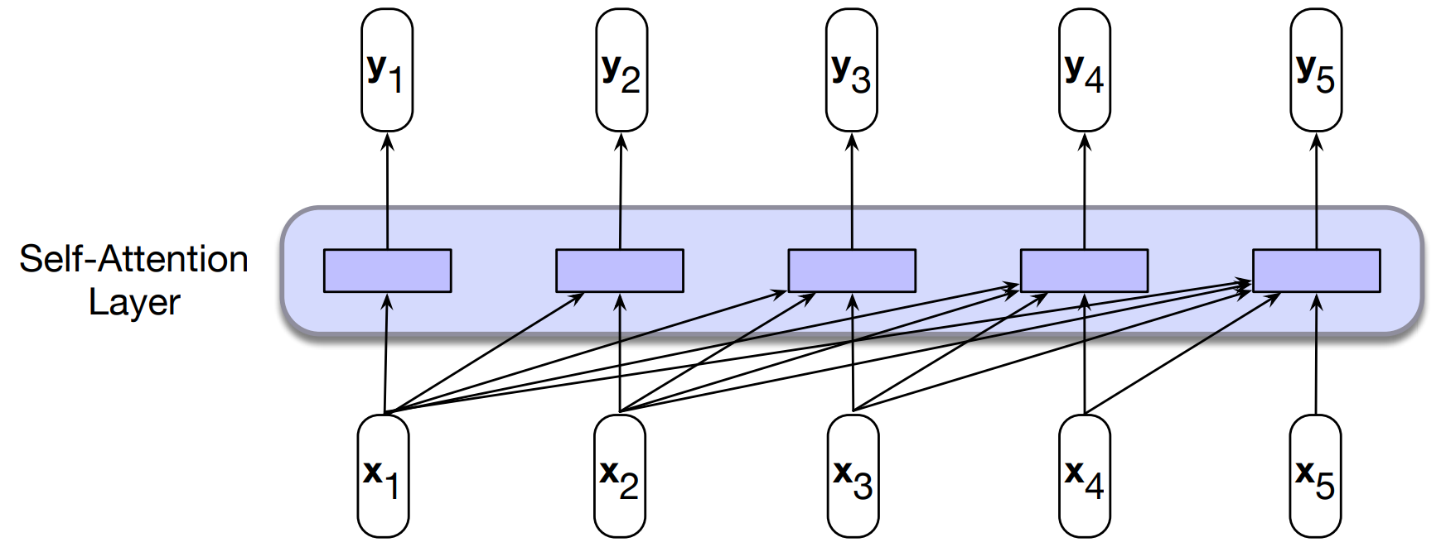
(Review) Self-Attention | Transformers
In processing each element of the sequence, the model attends to all the inputs up to, and including, the current one.
Unlike RNNs, the computations at each time step are independent of all the other steps and therefore can be performed in parallel.
Notes:
Self-Attention Layer:
The self-attention layer processes a sequence of input vectors $\left(x_{1} , x_{2} , … , x_{5}\right)$ and produces a sequence of output vectors $\left(y_{1} , y_{2} , … , y_{5}\right)$.
Each output vector $y_{i}$ is computed by attending to all input vectors up to and including the current one, allowing the model to capture dependencies and relationships within the sequence.
Parallel Computation:
Unlike RNNs, where computations are sequential and depend on previous steps, the self-attention mechanism allows for parallel processing.
Each element in the sequence can be processed independently, enabling efficient computation and scalability.
Attention Score Calculation:
Score Function:
The attention score between two input vectors $x_{i}$ and $x_{j}$ is calculated using the dot product: $$\text{score}\left(x_{i} , x_{j}\right)=x_{i}⋅x_{j}$$
This score measures the similarity or relevance between the two vectors.
Attention Weights:
The scores are normalized using the softmax function to produce attention weights $α_{ij}$:
These weights indicate the importance of each input vector in computing the output vector $y_{i}$.
Output Computation:
Each output vector $y_{i}$ is computed as a weighted sum of the input vectors: $$y_{i}=\sum_{j≤i}{α_{ij}}x_{j}$$
This operation allows the model to integrate information from the entire sequence, focusing on the most relevant parts for each output.
Key Insight:
Self-attention enables the model to capture complex dependencies and contextual information within sequences, making it highly effective for tasks that require understanding of long-range relationships.
The ability to process sequences in parallel makes transformers more efficient and scalable than traditional recurrent models, contributing to their widespread adoption in NLP and other fields.
These slides provide a comprehensive view of how self-attention works within transformers, highlighting its advantages in terms of efficiency and capability to model complex dependencies. This understanding is crucial for appreciating the transformative impact of transformers on modern AI research and applications.

Slide 19

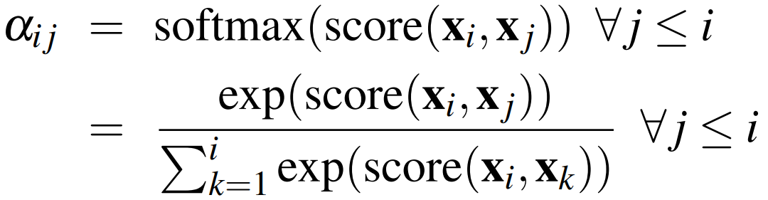
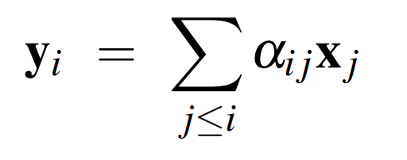
(Review) Self-Attention | Transformers
Notes:
Self-Attention Layer:
The self-attention layer processes a sequence of input vectors $\left(x_{1} , x_{2} , … , x_{5}\right)$ and produces a sequence of output vectors $\left(y_{1} , y_{2} , … , y_{5}\right)$.
Each output vector $y_{i}$ is computed by attending to all input vectors up to and including the current one, allowing the model to capture dependencies and relationships within the sequence.
Parallel Computation:
Unlike RNNs, where computations are sequential and depend on previous steps, the self-attention mechanism allows for parallel processing.
Each element in the sequence can be processed independently, enabling efficient computation and scalability.
Attention Score Calculation:
Score Function:
The attention score between two input vectors $x_{i}$ and $x_{j}$ is calculated using the dot product: $$\text{score}\left(x_{i} , x_{j}\right)=x_{i}⋅x_{j}$$
This score measures the similarity or relevance between the two vectors.
Attention Weights:
The scores are normalized using the softmax function to produce attention weights $α_{ij}$:
These weights indicate the importance of each input vector in computing the output vector $y_{i}$.
Output Computation:
Each output vector $y_{i}$ is computed as a weighted sum of the input vectors: $$y_{i}=\sum_{j≤i}{α_{ij}}x_{j}$$
This operation allows the model to integrate information from the entire sequence, focusing on the most relevant parts for each output.
Key Insight:
Self-attention enables the model to capture complex dependencies and contextual information within sequences, making it highly effective for tasks that require understanding of long-range relationships.
The ability to process sequences in parallel makes transformers more efficient and scalable than traditional recurrent models, contributing to their widespread adoption in NLP and other fields.
These slides provide a comprehensive view of how self-attention works within transformers, highlighting its advantages in terms of efficiency and capability to model complex dependencies. This understanding is crucial for appreciating the transformative impact of transformers on modern AI research and applications.

Slide 20
(Review) Self-Attention | Transformers
Let us understand how transformers uses self-attention !

Slide 21






(Review) Self-Attention | Transformers
,
,
In Vaswani et al., 2017, d was 1024.
Let us understand how transformers uses self-attention !
Query, Q
Key, K
Value, V
As the current focus of attention when being compared to all of the other preceding inputs.
In its role as a preceding input being compared to the current focus of attention.
As a value used to compute the output for the current focus of attention
Three different roles each x_{i} (input embedding) , in the computation of self attention
Notes:
Self-Attention Components:
Query, Key, and Value:
Each input vector $x_{i}$ is transformed into three different vectors: query $q_{i}$, key $k_{i}$, and value $v_{i}$.
These transformations are achieved using learnable weight matrices $W^{Q}$, $W^{K}$, and $W^{V}$, respectively.
Mathematical Transformations:
Query: $$q_{i}=W^{Q}x_{i}$$
The query vector represents the current focus of attention when comparing the input to other elements in the sequence.
Key: $$k_{i}=W^{K}x_{i}$$
The key vector is used to compare the current input with other inputs, helping determine the relevance of each element.
Value: $$v_{i}=W^{V}x_{i}$$
The value vector is used to compute the output for the current focus of attention, incorporating the information deemed relevant by the attention mechanism.
Roles in Self-Attention:
Query (Q): Acts as the current focus of attention, determining which parts of the input sequence are most relevant.
Key (K): Provides a basis for comparison, allowing the model to evaluate the relevance of each input element.
Value (V): Contains the information that will be used to compute the final output, weighted by the attention scores.
Key Insight:
The transformation of input vectors into queries, keys, and values allows the self-attention mechanism to efficiently compute attention scores and outputs.
By using learnable weight matrices, the model can adapt these transformations to optimize performance for specific tasks and datasets.
Historical Context:
In the original transformer model by Vaswani et al. (2017), the dimensionality $d$ of these vectors was set to 1024, reflecting the model's capacity to capture complex patterns and relationships.
This slide provides a foundational understanding of how self-attention operates within transformers, highlighting the importance of queries, keys, and values in computing attention. This understanding is crucial for appreciating the flexibility and power of transformers in handling a wide range of natural language processing tasks.

Slide 22
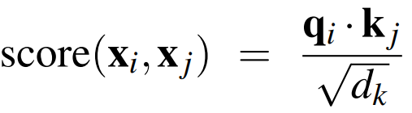
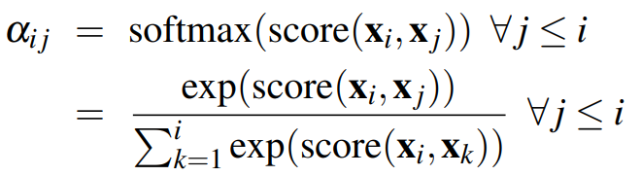
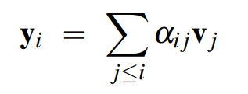
(Review) Self-Attention | Transformers
,
,
In Vaswani et al., 2017, d was 1024.
Let us understand how transformers uses self-attention !
The simple dot product can be an arbitrarily large;
scaled dot-product is used in transformers;
Notes:
Self-Attention Components:
Query, Key, and Value Transformations:
Each input vector $x_{i}$ is transformed into a query $q_{i}$, key $k_{i}$, and value $v_{i}$ using learnable weight matrices $W^{Q}$, $W^{K}$, and $W^{V}$: $$q_{i}=W^{Q}x_{i}, k_{i}=W^{K}x_{i}, v_{i}=W^{V}x_{i}$$
Scaled Dot-Product Attention:
Attention Score Calculation:
The attention score between two input vectors $x_{i}$ and $x_{j}$ is calculated using the dot product of their query and key vectors, scaled by the square root of the dimensionality $d_{k}$ of the key vectors: $$\text{score}\left(x_{i} , x_{j}\right)=\frac{q_{i}⋅k_{j}}{\sqrt{d_{k}}}$$
Scaling by $\sqrt{d_{k}}$ helps prevent the dot product from becoming too large, which can lead to small gradients and slow learning.
Attention Weights:
The scores are normalized using the softmax function to produce attention weights $α_{ij}$:
These weights determine the importance of each input vector in computing the output vector $y_{i}$.
Output Computation:
Weighted Sum of Values:
Each output vector $y_{i}$ is computed as a weighted sum of the value vectors, using the attention weights: $$y_{i}=\sum_{j≤i}{α_{ij}}v_{j}$$
This operation integrates information from the entire sequence, focusing on the most relevant parts for each output.
Key Insight:
The use of scaled dot-product attention allows the model to efficiently compute attention scores and outputs, capturing complex dependencies and relationships within sequences.
By transforming input vectors into queries, keys, and values, the model can dynamically adjust its focus, improving its ability to handle a wide range of tasks.
Historical Context:
In the original transformer model by Vaswani et al. (2017), the dimensionality $d$ was set to 1024, reflecting the model's capacity to capture detailed patterns and relationships.
This slide provides a detailed understanding of how self-attention operates within transformers, highlighting the importance of scaled dot-product attention in achieving efficient and effective sequence processing. This understanding is crucial for appreciating the transformative impact of transformers on modern AI research and applications.

Slide 23
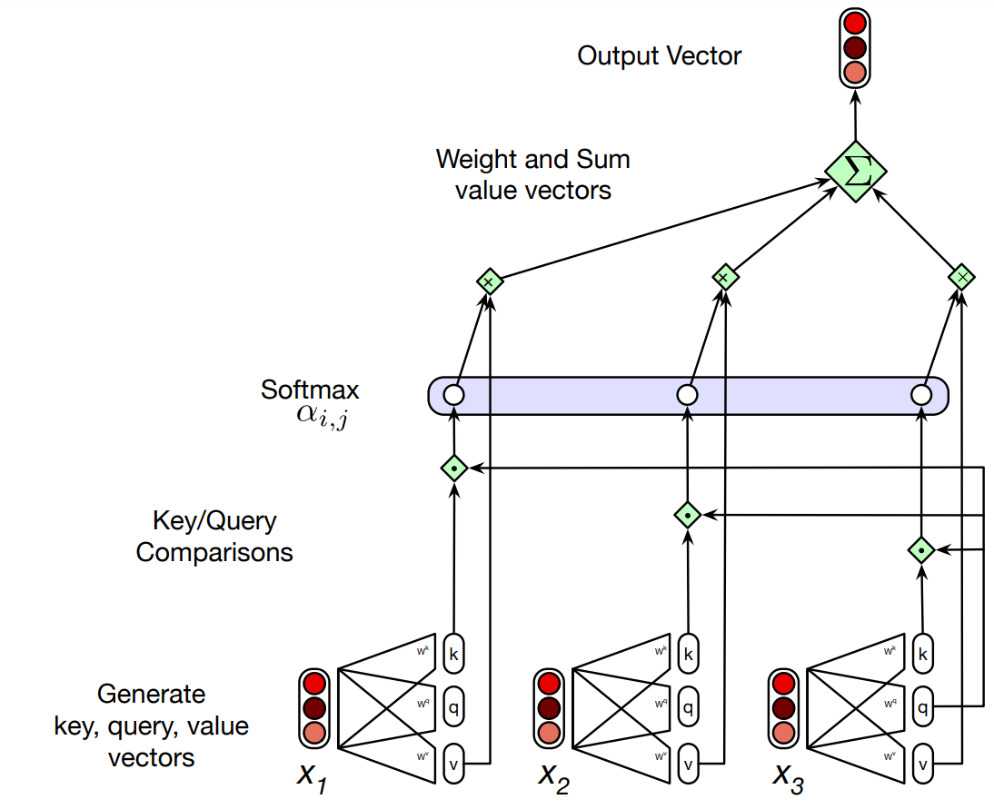
(Review) Self-Attention | Transformers
Each output, y_{i} , is computed independently
Entire process can be parallelized
Calculating the value of y3, the third element of a sequence using causal (left-to-right) self-attention
Notes:
Self-Attention Process:
Independent Computation:
Each output vector $y_{i}$ is computed independently, allowing for parallel processing of the entire sequence.
This independence is a key advantage of transformers over recurrent models, which require sequential processing.
Causal Self-Attention:
The diagram shows the calculation of $y_{3}$, the third element in the sequence, using causal self-attention.
Causal self-attention ensures that each output only attends to previous and current inputs, maintaining the left-to-right order necessary for tasks like language modeling.
Steps in the Diagram:
Generate Key, Query, and Value Vectors:
For each input $x_{i}$, generate the corresponding key $k_{i}$, query $q_{i}$, and value $v_{i}$ vectors using learnable weight matrices.
Key/Query Comparisons:
Compute the attention scores by comparing the query vector of the current element with the key vectors of all preceding elements.
Softmax Normalization:
Apply the softmax function to the attention scores to obtain attention weights $α_{i,j}$, which indicate the relevance of each input to the current output.
Weight and Sum Value Vectors:
Compute the output vector $y_{3}$ as a weighted sum of the value vectors, using the attention weights to focus on the most relevant inputs.
Key Insight:
The ability to compute each output independently and in parallel makes transformers highly efficient and scalable, enabling them to handle large sequences and complex tasks effectively.
Causal self-attention ensures that the model respects the sequential nature of certain tasks, such as language modeling, where future information should not influence current predictions.
This slide provides a clear visualization of the self-attention process in transformers, emphasizing the efficiency and flexibility of the architecture. Understanding this process is crucial for appreciating how transformers achieve state-of-the-art performance in various natural language processing tasks.

Slide 24

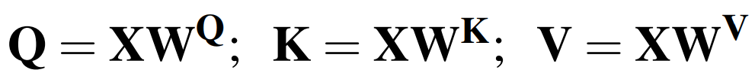
(Review) Self-Attention | Transformers
Pack the input embeddings of the N input tokens into a single matrix
> Each row of X is the embedding of one token of the input
Multiply X by the key, query, and value (dxd) matrices

Slide 25
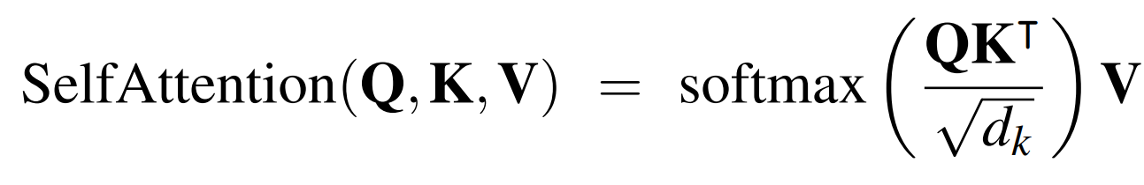
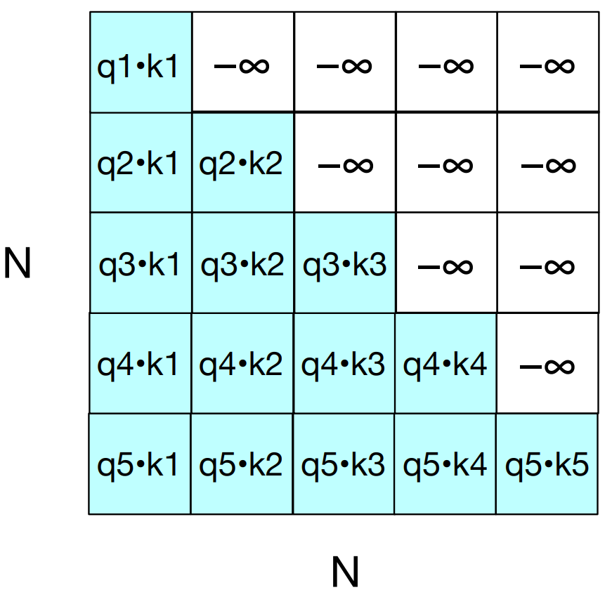

(Review) Self-Attention | Transformers
Matrix
Note: Upper-triangle portion of the comparisons matrix zeroed out (set to −∞, which the softmax will turn to zero)
Notes:
Self-Attention Formula:
The self-attention mechanism is computed using the formula: $$\text{SelfAttention}\left(Q , K , V\right)=\text{softmax}\left(\frac{QK^{T}}{\sqrt{d_{k}}}\right)V$$
Here, $Q$, $K$, and $V$ are the query, key, and value matrices, respectively, and $d_{k}$ is the dimensionality of the key vectors.
Matrix Operations:
Dot Product $QK^{T}$:
The matrix $QK^{T}$ is computed by taking the dot product of the query matrix $Q$ and the transpose of the key matrix $K$.
Each element $q_{i}⋅k_{j}$ in the matrix represents the attention score between the $i$-th query and the $j$-th key.
Scaling:
The scores are scaled by $\sqrt{d_{k}}$ to prevent them from becoming too large, which can lead to small gradients and slow learning.
Softmax Normalization:
The scaled scores are passed through the softmax function to produce attention weights, which sum to 1 for each query.
Weighted Sum of Values:
The attention weights are used to compute a weighted sum of the value vectors, resulting in the final output of the self-attention mechanism.
Causal Attention:
Masking Future Positions:
In tasks like language modeling, where causal (left-to-right) attention is required, the upper-triangle portion of the $QK^{T}$ matrix is masked (set to $−∞$).
This ensures that each position in the sequence only attends to previous and current positions, preventing information leakage from future tokens.
The softmax function turns these masked positions into zeros, effectively ignoring them in the attention computation.
Key Insight:
The use of matrix operations allows for efficient computation of self-attention, leveraging the power of linear algebra to handle large sequences and complex dependencies.
Masking is a crucial technique for ensuring the correct flow of information in tasks that require sequential processing.
This slide provides a detailed understanding of the self-attention computation in transformers, highlighting the importance of matrix operations and masking in achieving efficient and effective sequence processing. This understanding is essential for appreciating the design and performance advantages of transformers in handling a wide range of natural language processing tasks.

Slide 26
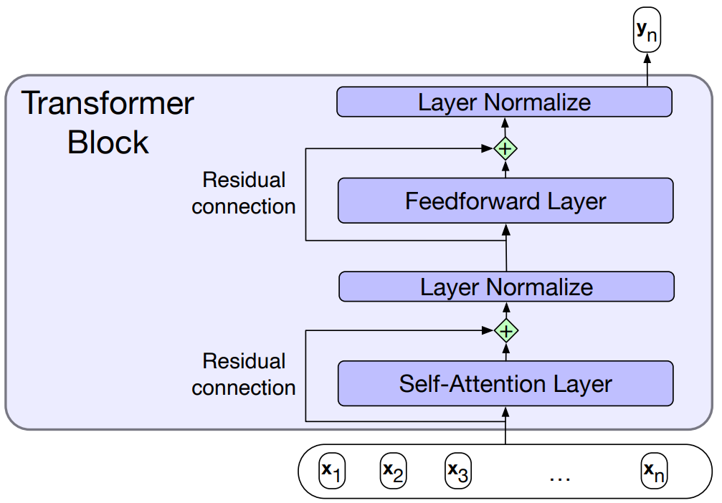
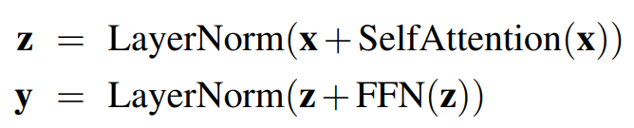
(Review) Transformer Blocks | Transformers
Notes:
Transformer Block Structure:
Self-Attention Layer:
The input sequence $\left(x_{1} , x_{2} , … , x_{n}\right)$ is first processed by the self-attention layer.
This layer computes attention scores and outputs for each input, capturing dependencies and relationships within the sequence.
Residual Connection and Layer Normalization:
A residual connection adds the original input $x$ to the output of the self-attention layer, helping to preserve the input information and facilitate gradient flow during training.
Layer normalization is applied to stabilize and accelerate training by normalizing the output: $$z=\text{LayerNorm}\left(x+\text{SelfAttention}\left(x\right)\right)$$
Feedforward Layer:
The normalized output $z$ is passed through a feedforward neural network, typically consisting of two linear transformations with a ReLU activation in between.
This layer allows the model to learn complex transformations and representations.
Residual Connection and Layer Normalization:
Another residual connection adds the output of the feedforward layer to $z$, followed by layer normalization: $$y=\text{LayerNorm}\left(z+\text{FFN}\left(z\right)\right)$$
This step ensures that the model can learn effectively by maintaining stable gradients and preserving input information.
Key Insight:
The combination of self-attention, feedforward layers, residual connections, and layer normalization allows transformer blocks to efficiently capture and process complex patterns in the input data.
Residual connections and layer normalization are crucial for stabilizing training and enabling the model to learn deep representations.
This slide provides a detailed understanding of the operations within a transformer block, highlighting the architectural choices that contribute to the model's efficiency and effectiveness. Understanding these components is essential for appreciating how transformers achieve state-of-the-art performance in various natural language processing tasks.

Slide 27
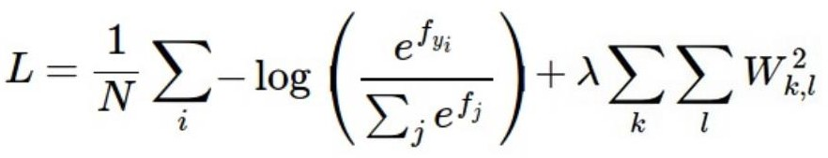
Summary
Have score function and loss function
Currently, score function is based on linear classifier
Next, will generalize to convolutional neural networks
Find W and b to minimize loss
Notes:
Score Function and Loss Function:
Score Function:
The score function is currently based on a linear classifier, which assigns scores to different classes based on input features.
The goal is to generalize this approach to convolutional neural networks, which can capture more complex patterns and spatial hierarchies in data.
Loss Function:
The loss function presented is a combination of a cross-entropy loss and a regularization term: $$L=\frac{1}{N}\sum_{i}{−}\log\left(\frac{e^{f_{y_{i}}}}{\sum_{j}{e^{f_{j}}}}\right)+λ\sum_{k,l}{W_{k,l}^{2}}$$
Cross-Entropy Loss: Measures the difference between the predicted probabilities and the true labels, encouraging the model to assign high probabilities to the correct classes.
Regularization Term: Adds a penalty for large weights, helping to prevent overfitting by encouraging simpler models. The regularization strength is controlled by the hyperparameter $λ$.
Optimization Objective:
The goal is to find the weight matrix $W$ and bias $b$ that minimize the loss function $L$.
This involves adjusting the model parameters to improve its performance on the training data while maintaining generalization to unseen data.
Key Insight:
The combination of a score function and a loss function provides a framework for training machine learning models, guiding the optimization process to achieve better predictions.
Generalizing from linear classifiers to CNNs allows for more powerful models capable of handling complex data, such as images and sequences.
This slide summarizes the foundational concepts of score and loss functions in machine learning, highlighting the importance of optimization in model training. Understanding these concepts is crucial for developing effective models that can generalize well to new data.

Slide 28
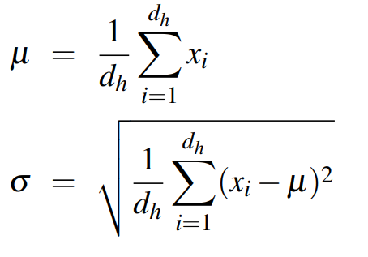
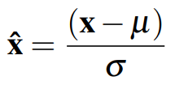

(Review) Transformer Blocks | Transformers
LayerNorm:
Notes:
Transformer Block Structure:
Self-Attention Layer:
The input sequence $\left(x_{1} , x_{2} , … , x_{n}\right)$ is first processed by the self-attention layer, which captures dependencies and relationships within the sequence.
Residual Connection and Layer Normalization:
A residual connection adds the original input $x$ to the output of the self-attention layer, followed by layer normalization: $$z=\text{LayerNorm}\left(x+\text{SelfAttention}\left(x\right)\right)$$
Feedforward Layer:
The normalized output $z$ is passed through a feedforward neural network, which typically consists of two linear transformations with a ReLU activation in between.
Residual Connection and Layer Normalization:
Another residual connection adds the output of the feedforward layer to $z$, followed by layer normalization: $$y=\text{LayerNorm}\left(z+\text{FFN}\left(z\right)\right)$$
Layer Normalization:
Mathematical Formulation:
Mean ($μ$): The mean of the input features is calculated: $$μ=\frac{1}{d_{h}}\sum_{i=1}^{d_{h}}{x_{i}}$$
Standard Deviation ($σ$): The standard deviation is computed:
Normalization ($\hat{x}$): The input is normalized: $$\hat{x}=\frac{x−μ}{σ}$$
Scale and Shift: The normalized input is scaled and shifted using learnable parameters $γ$ and $β$: $$\text{LayerNorm}=γ\hat{x}+β$$
Key Insight:
Layer normalization stabilizes and accelerates training by normalizing the inputs to each layer, ensuring that they have a consistent scale and distribution.
The use of residual connections and layer normalization helps maintain stable gradients and preserve input information, enabling the model to learn deep representations effectively.
This slide provides a comprehensive understanding of the operations within a transformer block, emphasizing the importance of layer normalization in achieving efficient and effective training. Understanding these components is crucial for appreciating how transformers achieve state-of-the-art performance in various natural language processing tasks.

Slide 29
(Review) Multihead-Attention | Transformers
Different words in a sentence can relate to each other in many different ways simultaneously
>> A single transformer block to learn to capture all of the different kinds of parallel relations among its inputs is inadequate.
Multihead self-attention layers
>> Heads ⇒ sets of self-attention layers, that reside in parallel layers at the same depth in a model, each with its own set of parameters.
>> Each head learn different aspects of the relationships that exist among inputs at the same level of abstraction
Notes:
Complex Relationships in Sentences:
Words in a sentence can relate to each other in various ways simultaneously. For example, a word might have syntactic, semantic, or positional relationships with other words.
A single transformer block with a single attention mechanism might be inadequate to capture all these diverse relationships effectively.
Multihead Self-Attention:
Multiple Heads:
Multihead attention involves using multiple sets of self-attention layers, known as "heads," that operate in parallel at the same depth in the model.
Each head has its own set of parameters, allowing it to focus on different aspects of the input relationships.
Learning Diverse Relationships:
Each attention head learns to capture different aspects of the relationships among inputs at the same level of abstraction.
By having multiple heads, the model can simultaneously attend to different parts of the input sequence, capturing a richer set of dependencies and interactions.
Key Insight:
Multihead attention enhances the model's ability to understand complex and diverse relationships in the input data, leading to more robust and accurate representations.
This approach allows transformers to handle a wide range of natural language processing tasks effectively, as it can capture both local and global dependencies within sequences.
This slide provides a clear understanding of the multihead attention mechanism in transformers, emphasizing its importance in capturing complex relationships in data. Understanding this concept is crucial for appreciating how transformers achieve state-of-the-art performance in various NLP tasks by leveraging the power of parallel attention mechanisms.

Slide 30
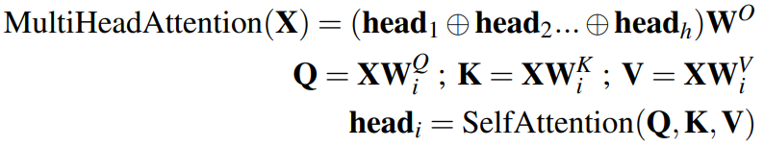
(Review) Multihead-Attention | Transformers
Different words in a sentence can relate to each other in many different ways simultaneously
>> A single transformer block to learn to capture all of the different kinds of parallel relations among its inputs is inadequate.
Multihead self-attention layers
>> Heads ⇒ sets of self-attention layers, that reside in parallel layers at the same depth in a model, each with its own set of parameters.
>> Each head learn different aspects of the relationships that exist among inputs at the same level of abstraction
Notes:
Complex Relationships in Sentences:
Words in a sentence can relate to each other in various ways simultaneously, such as syntactic, semantic, or positional relationships.
A single transformer block with a single attention mechanism might be inadequate to capture all these diverse relationships effectively.
Multihead Self-Attention:
Multiple Heads:
Multihead attention involves using multiple sets of self-attention layers, known as "heads," that operate in parallel at the same depth in the model.
Each head has its own set of parameters, allowing it to focus on different aspects of the input relationships.
Learning Diverse Relationships:
Each attention head learns to capture different aspects of the relationships among inputs at the same level of abstraction.
By having multiple heads, the model can simultaneously attend to different parts of the input sequence, capturing a richer set of dependencies and interactions.
Mathematical Formulation:
Multihead Attention Output: $$\text{MultiHeadAttention}\left(X\right)=\left({\text{head}}_{1}⊕{\text{head}}_{2}⊕…⊕{\text{head}}_{h}\right)W^{O}$$
The outputs of the individual heads are concatenated (denoted by $⊕$) and then linearly transformed using a weight matrix $W^{O}$.
Individual Head Computation: $$Q=XW^{Q}, K=XW^{K}, V=XW^{V} \\ {\text{head}}_{i}=\text{SelfAttention}\left(Q , K , V\right)$$
Each head computes its own set of query, key, and value matrices using different weight matrices $W^{Q}$, $W^{K}$, and $W^{V}$.
The self-attention mechanism is applied to these matrices to compute the output for each head.
Key Insight:
Multihead attention enhances the model's ability to understand complex and diverse relationships in the input data, leading to more robust and accurate representations.
This approach allows transformers to handle a wide range of natural language processing tasks effectively, as it can capture both local and global dependencies within sequences.
This slide provides a comprehensive understanding of the multihead attention mechanism in transformers, highlighting its importance in capturing complex relationships in data. Understanding this concept is crucial for appreciating how transformers achieve state-of-the-art performance in various NLP tasks by leveraging the power of parallel attention mechanisms.

Slide 31
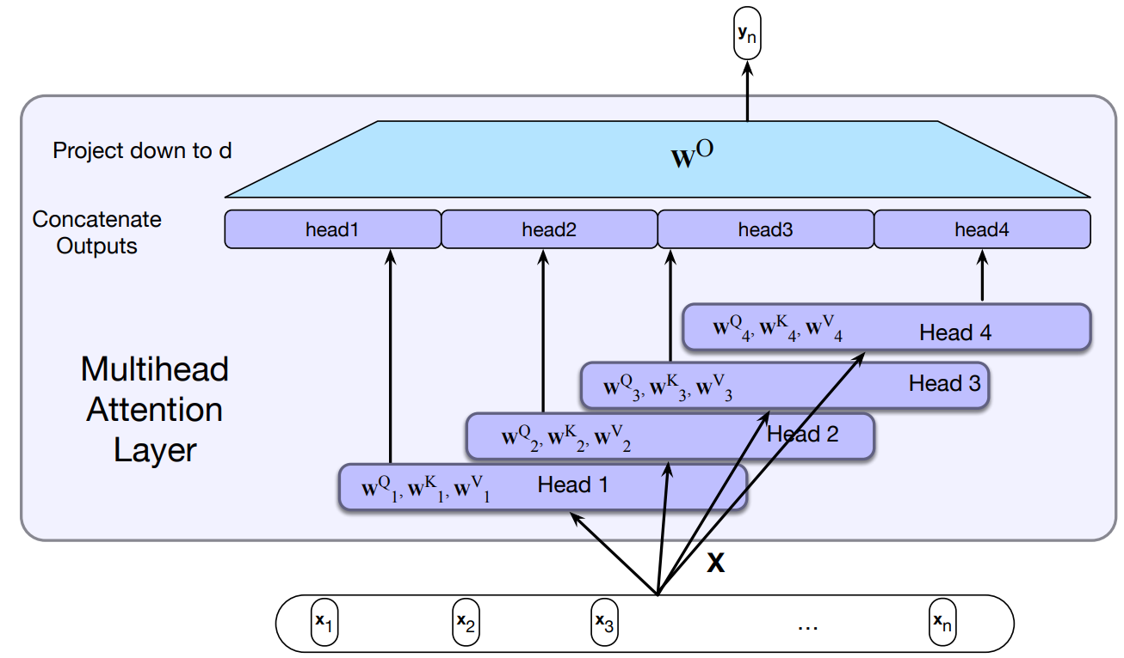
(Review) Multihead-Attention | Transformers
Each of the multihead self-attention layers is provided with its own set of key, query and value weight matrices.
The outputs from each of the layers are concatenated and then projected down to d, thus producing an output of the same size as the input so layers can be stacked.
Notes:
Multihead Attention Layer:
Parallel Attention Heads:
The input sequence $\left(x_{1} , x_{2} , … , x_{n}\right)$ is processed by multiple attention heads, each with its own set of key, query, and value weight matrices $\left(W_{i}^{Q} , W_{i}^{K} , W_{i}^{V}\right)$.
Each head independently computes its own attention output, capturing different aspects of the relationships among the input tokens.
Concatenation of Outputs:
The outputs from each attention head are concatenated to form a single combined output.
This concatenation allows the model to integrate the diverse information captured by each head.
Projection to Output Dimension:
The concatenated output is linearly transformed using a weight matrix $W^{O}$ to project it back down to the original input dimension $d$.
This projection ensures that the output of the multihead attention layer has the same size as the input, allowing for stacking of multiple layers.
Key Insight:
Each attention head focuses on different aspects of the input data, enabling the model to capture a richer set of dependencies and interactions.
The process of concatenating and projecting the outputs allows the model to integrate the diverse information captured by each head, enhancing its ability to understand complex relationships in the data.
Benefits of Multihead Attention:
By using multiple heads, the transformer can simultaneously attend to different parts of the input sequence, capturing both local and global dependencies.
This approach improves the model's ability to handle a wide range of natural language processing tasks, leading to more robust and accurate representations.
This slide provides a clear understanding of the multihead attention mechanism in transformers, emphasizing its importance in capturing complex relationships in data. Understanding this concept is crucial for appreciating how transformers achieve state-of-the-art performance in various NLP tasks by leveraging the power of parallel attention mechanisms

Slide 32
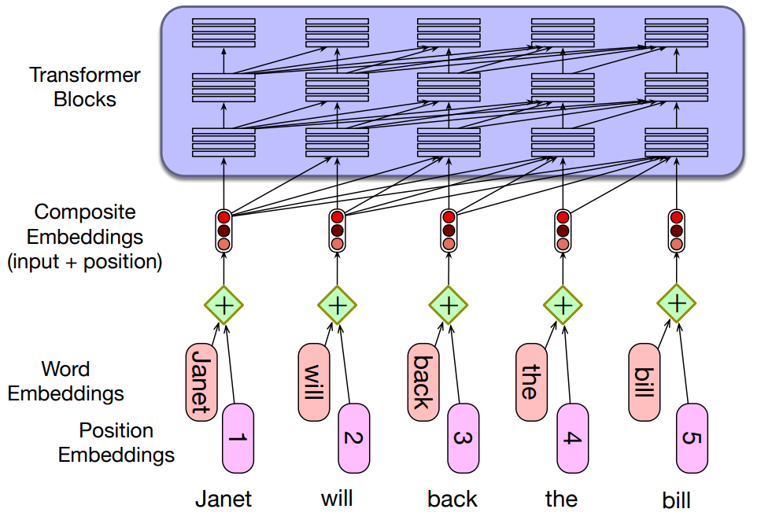
(Review) Positional Embeddings | Transformers
A simple way to model position:
Add an embedding representation of the absolute position to the input word embedding to produce a new embedding of the same dimensionality.
A combination of sine and cosine functions with differing frequencies was used in the original transformer work.
Notes:
Positional Embeddings:
Need for Positional Information:
Transformers process input sequences in parallel, which means they do not inherently capture the order of words. Positional embeddings are used to provide this information.
Composite Embeddings:
Each word in the input sequence is represented by a word embedding.
A positional embedding, representing the absolute position of the word in the sequence, is added to the word embedding to form a composite embedding.
This composite embedding retains the same dimensionality as the original word embedding.
Modeling Position:
A simple way to model position is by adding the positional embedding to the word embedding.
This addition allows the model to differentiate between words based on their position in the sequence.
Sine and Cosine Functions:
In the original transformer work, a combination of sine and cosine functions with differing frequencies was used to generate positional embeddings.
These functions provide a continuous and smooth representation of positions, allowing the model to generalize to sequences of different lengths.
Key Insight:
Positional embeddings enable transformers to capture the sequential nature of input data, which is crucial for tasks like language modeling and translation.
By incorporating positional information, the model can understand the order and structure of the input sequence, leading to more accurate and meaningful representations.
Benefits of Positional Embeddings:
They allow the model to leverage the order of words, which is essential for understanding context and meaning in natural language processing tasks.
The use of sine and cosine functions provides a flexible and effective way to encode positional information, supporting the model's ability to handle sequences of varying lengths.
This slide provides a clear understanding of the role of positional embeddings in transformers, highlighting their importance in capturing the order of words in a sequence. Understanding this concept is crucial for appreciating how transformers achieve state-of-the-art performance in various NLP tasks by effectively modeling sequential data.

Slide 33
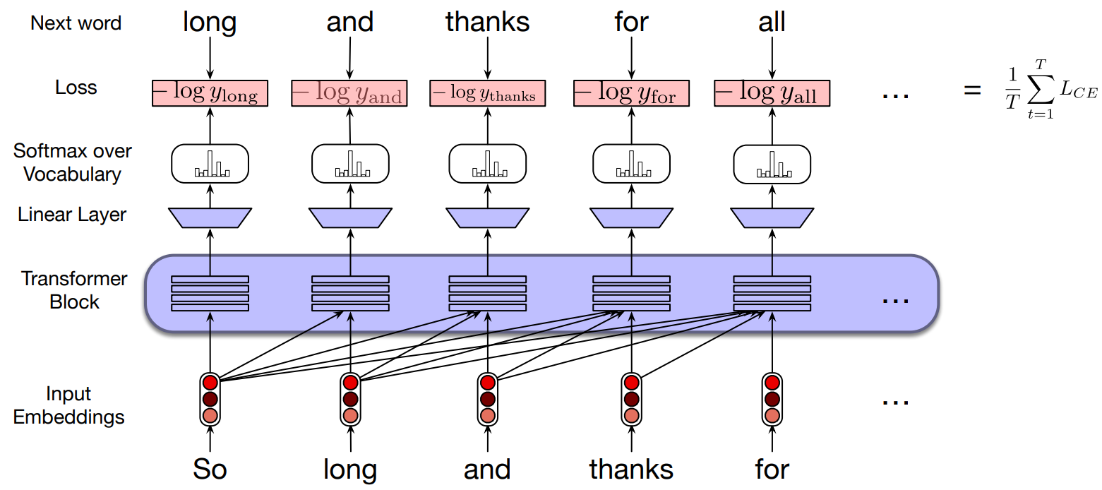
(Review) Transformers as Language Models
Notes:
Language Modeling with Transformers:
Input Embeddings:
The input sequence ("So long and thanks for") is converted into embeddings, which are fed into the transformer blocks.
These embeddings capture the semantic and syntactic information of the words.
Transformer Blocks:
The input embeddings are processed through a series of transformer blocks, which apply self-attention and feedforward operations to capture dependencies and relationships within the sequence.
Linear Layer:
The output of the transformer blocks is passed through a linear layer, which maps the high-dimensional representation to a vector of logits for each word in the vocabulary.
Softmax over Vocabulary:
The logits are converted into probabilities using the softmax function, which produces a probability distribution over the vocabulary for each position in the sequence.
Next Word Prediction:
The model predicts the next word in the sequence by selecting the word with the highest probability from the softmax output.
Loss Computation:
The negative log-likelihood loss (cross-entropy loss) is computed for each predicted word, comparing the predicted probabilities to the true next words ("long," "and," "thanks," "for," "all").
The average loss over the sequence is calculated as: $$\frac{1}{T}\sum_{t=1}^{T}{L_{CE}}$$
This loss is used to update the model parameters during training.
Key Insight:
Transformers as language models can effectively predict the next word in a sequence by capturing complex dependencies and relationships through self-attention.
The use of cross-entropy loss provides a robust framework for training the model to improve its predictions over time.
Benefits of Transformers for Language Modeling:
They can handle long-range dependencies and capture rich contextual information, leading to more accurate and coherent predictions.
The parallel processing capability of transformers allows for efficient training and inference, making them suitable for large-scale language modeling tasks.
This slide provides a comprehensive understanding of how transformers are used as language models, highlighting the flow of data and the role of key components in the prediction process. Understanding this process is crucial for appreciating the power and flexibility of transformers in natural language processing tasks.

Slide 34
Vision Transformers

Slide 35



Vision Transformer (ViT)
CV10 Attention - Transformers - Vision Transformer
Dosovitskiy et al, “An Image is Worth 16x16 Words: Transformers for Image Recognition at Scale”, ICLR 2021
Cat image is free for commercial use under a Pixabay license

Slide 36









Vision Transformer (ViT)
CV10 Attention - Transformers - Vision Transformer
Dosovitskiy et al, “An Image is Worth 16x16 Words: Transformers for Image Recognition at Scale”, ICLR 2021
Cat image is free for commercial use under a Pixabay license
Notes:
Vision Transformer (ViT):
Image as Patches:
The image is divided into smaller, non-overlapping patches, each of a fixed size (e.g., 16x16 pixels).
This division is analogous to tokenizing a sentence in NLP, where each patch acts as a "word" or "token."
Patch Embeddings:
Each image patch is flattened and linearly transformed into a vector, creating a patch embedding.
These embeddings are similar to word embeddings in NLP, capturing the features of each patch.
Transformer Processing:
The sequence of patch embeddings is fed into a transformer model, which applies self-attention and feedforward operations to capture dependencies and relationships between patches.
The transformer processes the patches in parallel, leveraging its ability to model long-range dependencies and interactions.
Image Recognition:
The output of the transformer is used for image classification or other vision tasks.
The model can learn to recognize patterns and features across the entire image, similar to how it processes sequences in NLP.
Key Insight:
The Vision Transformer leverages the strengths of transformers, such as parallel processing and the ability to capture complex dependencies, to handle image data effectively.
By treating image patches as tokens, ViT can apply the same powerful techniques used in NLP to vision tasks, achieving competitive performance on image recognition benchmarks.
Benefits of Vision Transformers:
They can handle large-scale image data efficiently, benefiting from the scalability and flexibility of the transformer architecture.
ViT models can capture both local and global features in images, leading to robust and accurate image recognition.
This slide provides an overview of how the Vision Transformer adapts the transformer architecture for image recognition, highlighting the innovative approach of treating image patches as tokens. Understanding this concept is crucial for appreciating the versatility and power of transformers in various domains beyond NLP.

Slide 37
Vision Transformer (ViT)
CV10 Attention - Transformers - Vision Transformer
N input patches, each of shape 3x16x16
Dosovitskiy et al, “An Image is Worth 16x16 Words: Transformers for Image Recognition at Scale”, ICLR 2021
Cat image is free for commercial use under a Pixabay license

Slide 38
Vision Transformer (ViT)
CV10 Attention - Transformers - Vision Transformer
Linear projection to D-dimensional vector
N input patches, each of shape 3x16x16
Dosovitskiy et al, “An Image is Worth 16x16 Words: Transformers for Image Recognition at Scale”, ICLR 2021
Cat image is free for commercial use under a Pixabay license

Slide 39
Vision Transformer (ViT)
CV10 Attention - Transformers - Vision Transformer
Add positional embedding: learned D- dim vector per position
+ + + + + + + + +
Linear projection to D-dimensional vector
N input patches, each of shape 3x16x16
Dosovitskiy et al, “An Image is Worth 16x16 Words: Transformers for Image Recognition at Scale”, ICLR 2021
Cat image is free for commercial use under a Pixabay license

Slide 40
Vision Transformer (ViT)
Output vectors
Exact same as NLP Transformer!
Transformer
Add positional embedding: learned D- dim vector per position
Linear projection to
+ + + + + + + + +
D-dimensional vector
N input patches, each of shape 3x16x16
Dosovitskiy et al, “An Image is Worth 16x16 Words: Transformers for Image Recognition at Scale”, ICLR 2021
Cat image is free for commercial use under a Pixabay license

Slide 41
Vision Transformer (ViT)
Output vectors
Exact same as NLP Transformer!
Transformer
Add positional embedding: learned D- dim vector per position
Linear projection to
Special extra input: classification token (D dims, learned)
+ + + + + + + + +
D-dimensional vector
N input patches, each of shape 3x16x16
Dosovitskiy et al, “An Image is Worth 16x16 Words: Transformers for Image Recognition at Scale”, ICLR 2021
Cat image is free for commercial use under a Pixabay license

Slide 42
Vision Transformer (ViT)
Linear projection to C-dim vector of predicted class scores
Output vectors
Exact same as NLP Transformer!
Transformer
Add positional embedding: learned D- dim vector per position
Linear projection to
Special extra input: classification token (D dims, learned)
+ + + + + + + + +
D-dimensional vector
N input patches, each of shape 3x16x16
Dosovitskiy et al, “An Image is Worth 16x16 Words: Transformers for Image Recognition at Scale”, ICLR 2021
Cat image is free for commercial use under a Pixabay license

Slide 43
Vision Transformer (ViT)
Computer vision model with no convolutions!
Linear projection to C-dim vector of predicted class scores
Output vectors
Exact same as NLP Transformer!
Transformer
Add positional embedding: learned D- dim vector per position
Linear projection to
Special extra input: classification token (D dims, learned)
+ + + + + + + + +
D-dimensional vector
N input patches, each of shape 3x16x16
Dosovitskiy et al, “An Image is Worth 16x16 Words: Transformers for Image Recognition at Scale”, ICLR 2021
Cat image is free for commercial use under a Pixabay license

Slide 44
Vision Transformer (ViT)
Computer vision model with no convolutions!
Not quite: With patch size p, first layer is Conv2D(pxp, 3->D, stride=p)
Linear projection to C-dim vector of predicted class scores
Output vectors
Exact same as NLP Transformer!
Transformer
Add positional embedding: learned D- dim vector per position
Linear projection to
Special extra input: classification token (D dims, learned)
+ + + + + + + + +
D-dimensional vector
N input patches, each of shape 3x16x16
Dosovitskiy et al, “An Image is Worth 16x16 Words: Transformers for Image Recognition at Scale”, ICLR 2021
Cat image is free for commercial use under a Pixabay license
Notes:
Vision Transformer (ViT) Architecture:
Image Patches:
The input image is divided into $N$ non-overlapping patches, each of size $3×16×16$ (3 channels for RGB, and 16x16 pixels per patch).
These patches are treated as input tokens, similar to words in a sentence for NLP tasks.
Linear Projection:
Each patch is flattened and linearly projected into a $D$-dimensional vector, creating a patch embedding.
This step is analogous to creating word embeddings in NLP.
Positional Embeddings:
Positional embeddings are added to each patch embedding to incorporate information about the position of each patch in the image.
These embeddings are learned $D$-dimensional vectors, ensuring the model can capture the spatial structure of the image.
Transformer Processing:
The sequence of patch embeddings, along with a special classification token, is fed into a transformer model.
The transformer applies self-attention and feedforward operations to capture dependencies and relationships between patches.
Classification Token:
A special classification token is prepended to the sequence of patch embeddings. This token aggregates information from all patches and is used for the final classification task.
Output and Classification:
The output of the transformer is a set of vectors, including the transformed classification token.
A linear layer projects the classification token to a $C$-dimensional vector, representing the predicted class scores.
Key Insight:
The Vision Transformer leverages the transformer architecture's ability to model long-range dependencies and interactions, applying it to image data without relying on convolutions.
By treating image patches as tokens, ViT can effectively capture both local and global features, leading to competitive performance on image recognition tasks.
Benefits of Vision Transformers:
They offer a flexible and scalable approach to image recognition, benefiting from the parallel processing capabilities of transformers.
ViT models can handle large-scale image data efficiently, making them suitable for various computer vision applications.
This slide provides a comprehensive understanding of the Vision Transformer architecture, highlighting its innovative approach to image recognition by adapting the transformer model for vision tasks. Understanding this concept is crucial for appreciating the versatility and power of transformers in domains beyond NLP.

Slide 45
Vision Transformer (ViT)
Computer vision model with no convolutions!
Not quite: MLPs in Transformer are stacks of 1x1 convolution
Linear projection to C-dim vector of predicted class scores
Output vectors
Exact same as NLP Transformer!
Transformer
Add positional embedding: learned D- dim vector per position
Linear projection to
Special extra input: classification token (D dims, learned)
+ + + + + + + + +
D-dimensional vector
N input patches, each of shape 3x16x16
Dosovitskiy et al, “An Image is Worth 16x16 Words: Transformers for Image Recognition at Scale”, ICLR 2021
Cat image is free for commercial use under a Pixabay license
Notes:
Vision Transformer (ViT) Architecture:
Image Patches:
The input image is divided into $N$ non-overlapping patches, each of size $3×16×16$ (3 channels for RGB, and 16x16 pixels per patch).
These patches are treated as input tokens, similar to words in a sentence for NLP tasks.
Linear Projection:
Each patch is flattened and linearly projected into a $D$-dimensional vector, creating a patch embedding.
This step is analogous to creating word embeddings in NLP.
Positional Embeddings:
Positional embeddings are added to each patch embedding to incorporate information about the position of each patch in the image.
These embeddings are learned $D$-dimensional vectors, ensuring the model can capture the spatial structure of the image.
Transformer Processing:
The sequence of patch embeddings, along with a special classification token, is fed into a transformer model.
The transformer applies self-attention and feedforward operations to capture dependencies and relationships between patches.
MLPs and 1x1 Convolutions:
The slide notes that the MLPs in the transformer can be thought of as stacks of 1x1 convolutions. This is a conceptual way to understand how MLPs operate on each patch independently, similar to how 1x1 convolutions process each pixel or patch.
Classification Token:
A special classification token is prepended to the sequence of patch embeddings. This token aggregates information from all patches and is used for the final classification task.
Output and Classification:
The output of the transformer is a set of vectors, including the transformed classification token.
A linear layer projects the classification token to a $C$-dimensional vector, representing the predicted class scores.
Key Insight:
The Vision Transformer leverages the transformer architecture's ability to model long-range dependencies and interactions, applying it to image data without relying on traditional convolutions.
By treating image patches as tokens, ViT can effectively capture both local and global features, leading to competitive performance on image recognition tasks.
Benefits of Vision Transformers:
They offer a flexible and scalable approach to image recognition, benefiting from the parallel processing capabilities of transformers.
ViT models can handle large-scale image data efficiently, making them suitable for various computer vision applications.
This slide provides a comprehensive understanding of the Vision Transformer architecture, highlighting its innovative approach to image recognition by adapting the transformer model for vision tasks. Understanding this concept is crucial for appreciating the versatility and power of transformers in domains beyond NLP.

Slide 46
Vision Transformer (ViT)
In practice: take 224x224 input image,
Each attention matrix has 14⁴ = 38,416 entries, takes 150 KB
(or 65,536 entries, takes 256 KB)
divide into 14x14 grid of 16x16 pixel patches (or 16x16 grid of 14x14 patches)
Linear projection to C-dim vector of predicted class scores
Output vectors
Exact same as NLP Transformer!
Transformer
Add positional embedding: learned D- dim vector per position
Linear projection to
Special extra input: classification token (D dims, learned)
+ + + + + + + + +
D-dimensional vector
N input patches, each of shape 3x16x16
Dosovitskiy et al, “An Image is Worth 16x16 Words: Transformers for Image Recognition at Scale”, ICLR 2021
Cat image is free for commercial use under a Pixabay license
Notes:
Slide Explanation:
Vision Transformer (ViT) Architecture:
Image Patching:
A typical input image of size $224×224$ pixels is divided into a grid of patches. For example, it can be divided into a $14×14$ grid of $16×16$ pixel patches.
Alternatively, a $16×16$ grid of $14×14$ patches can be used, depending on the implementation.
Patch Embeddings:
Each patch is flattened and linearly projected into a $D$-dimensional vector, creating a patch embedding.
Positional embeddings are added to each patch embedding to incorporate spatial information.
Transformer Processing:
The sequence of patch embeddings, along with a special classification token, is fed into a transformer model.
The transformer applies self-attention and feedforward operations to capture dependencies and relationships between patches.
Attention Matrix Size:
Each attention matrix in the transformer has $14^{4}=38,416$ entries, which takes approximately 150 KB of memory.
If using a $16×16$ grid, the attention matrix has $65,536$ entries, taking approximately 256 KB.
Output and Classification:
The output of the transformer includes a set of vectors, with the classification token being used for the final classification task.
A linear layer projects the classification token to a $C$-dimensional vector, representing the predicted class scores.
Key Insight:
The Vision Transformer leverages the transformer architecture's ability to model long-range dependencies and interactions, applying it to image data without relying on traditional convolutions.
By treating image patches as tokens, ViT can effectively capture both local and global features, leading to competitive performance on image recognition tasks.
Benefits of Vision Transformers:
They offer a flexible and scalable approach to image recognition, benefiting from the parallel processing capabilities of transformers.
ViT models can handle large-scale image data efficiently, making them suitable for various computer vision applications.
This slide provides a comprehensive understanding of the Vision Transformer architecture, highlighting its innovative approach to image recognition by adapting the transformer model for vision tasks. Understanding this concept is crucial for appreciating the versatility and power of transformers in domains beyond NLP.

Slide 47
Vision Transformer (ViT)
In practice: take 224x224 input image, divide into 14x14 grid of 16x16 pixel patches (or 16x16 grid of 14x14 patches)
With 48 layers, 16 heads per layer, all attention matrices take 112 MB (or 192MB)
Linear projection to C-dim vector of predicted class scores
Output vectors
Exact same as NLP Transformer!
Transformer
Add positional embedding: learned D- dim vector per position
Linear projection to
Special extra input: classification token (D dims, learned)
+ + + + + + + + +
D-dimensional vector
N input patches, each of shape 3x16x16
Dosovitskiy et al, “An Image is Worth 16x16 Words: Transformers for Image Recognition at Scale”, ICLR 2021
Cat image is free for commercial use under a Pixabay license
Notes:
Vision Transformer (ViT) Architecture:
Image Patching:
A typical input image of size $224×224$ pixels is divided into a grid of patches. For example, it can be divided into a $14×14$ grid of $16×16$ pixel patches.
Alternatively, a $16×16$ grid of $14×14$ patches can be used, depending on the implementation.
Patch Embeddings:
Each patch is flattened and linearly projected into a $D$-dimensional vector, creating a patch embedding.
Positional embeddings are added to each patch embedding to incorporate spatial information.
Transformer Processing:
The sequence of patch embeddings, along with a special classification token, is fed into a transformer model.
The transformer applies self-attention and feedforward operations to capture dependencies and relationships between patches.
Attention Matrix Size and Memory:
With 48 layers and 16 heads per layer, the attention matrices require significant memory.
All attention matrices together take approximately 112 MB of memory (or 192 MB, depending on the configuration).
Output and Classification:
The output of the transformer includes a set of vectors, with the classification token being used for the final classification task.
A linear layer projects the classification token to a $C$-dimensional vector, representing the predicted class scores.
Key Insight:
The Vision Transformer leverages the transformer architecture's ability to model long-range dependencies and interactions, applying it to image data without relying on traditional convolutions.
By treating image patches as tokens, ViT can effectively capture both local and global features, leading to competitive performance on image recognition tasks.
Benefits of Vision Transformers:
They offer a flexible and scalable approach to image recognition, benefiting from the parallel processing capabilities of transformers.
ViT models can handle large-scale image data efficiently, making them suitable for various computer vision applications.
Computational Considerations:
The memory requirements for attention matrices are significant, especially with deep transformer architectures and multiple attention heads.
Efficient implementation and hardware considerations are important for deploying ViT models at scale.
This slide provides a comprehensive understanding of the Vision Transformer architecture, highlighting its innovative approach to image recognition by adapting the transformer model for vision tasks. Understanding this concept is crucial for appreciating the versatility and power of transformers in domains beyond NLP, as well as the computational considerations involved in their implementation.

Slide 48
Vision Transformer (ViT)
In practice: take 224x224 input image, divide into 14x14 grid of 16x16 pixel patches (or 16x16 grid of 14x14 patches)
With 48 layers, 16 heads per layer, all attention matrices take 112 MB (or 192MB)
Linear projection to C-dim vector of predicted class scores
Output vectors
Exact same as NLP Transformer!
Transformer
Add positional embedding: learned D- dim vector per position
Linear projection to
Special extra input: classification token (D dims, learned)
+ + + + + + + + +
D-dimensional vector
N input patches, each of shape 3x16x16
Dosovitskiy et al, “An Image is Worth 16x16 Words: Transformers for Image Recognition at Scale”, ICLR 2021
Cat image is free for commercial use under a Pixabay license
Notes:
Vision Transformer (ViT) Architecture:
Image Patching:
A typical input image of size $224×224$ pixels is divided into a grid of patches. For example, it can be divided into a $14×14$ grid of $16×16$ pixel patches.
Alternatively, a $16×16$ grid of $14×14$ patches can be used, depending on the implementation.
Patch Embeddings:
Each patch is flattened and linearly projected into a $D$-dimensional vector, creating a patch embedding.
Positional embeddings are added to each patch embedding to incorporate spatial information, similar to how positional embeddings are used in NLP transformers.
Transformer Processing:
The sequence of patch embeddings, along with a special classification token, is fed into a transformer model.
The transformer applies self-attention and feedforward operations to capture dependencies and relationships between patches.
Attention Matrix Size and Memory:
With 48 layers and 16 heads per layer, the attention matrices require significant memory.
All attention matrices together take approximately 112 MB of memory (or 192 MB, depending on the configuration).
Output and Classification:
The output of the transformer includes a set of vectors, with the classification token being used for the final classification task.
A linear layer projects the classification token to a $C$-dimensional vector, representing the predicted class scores.
Key Insight:
The Vision Transformer leverages the transformer architecture's ability to model long-range dependencies and interactions, applying it to image data without relying on traditional convolutions.
By treating image patches as tokens, ViT can effectively capture both local and global features, leading to competitive performance on image recognition tasks.
Benefits of Vision Transformers:
They offer a flexible and scalable approach to image recognition, benefiting from the parallel processing capabilities of transformers.
ViT models can handle large-scale image data efficiently, making them suitable for various computer vision applications.
Computational Considerations:
The memory requirements for attention matrices are significant, especially with deep transformer architectures and multiple attention heads.
Efficient implementation and hardware considerations are important for deploying ViT models at scale.
This slide provides a comprehensive understanding of the Vision Transformer architecture, highlighting its innovative approach to image recognition by adapting the transformer model for vision tasks. Understanding this concept is crucial for appreciating the versatility and power of transformers in domains beyond NLP, as well as the computational considerations involved in their implementation.

Slide 49
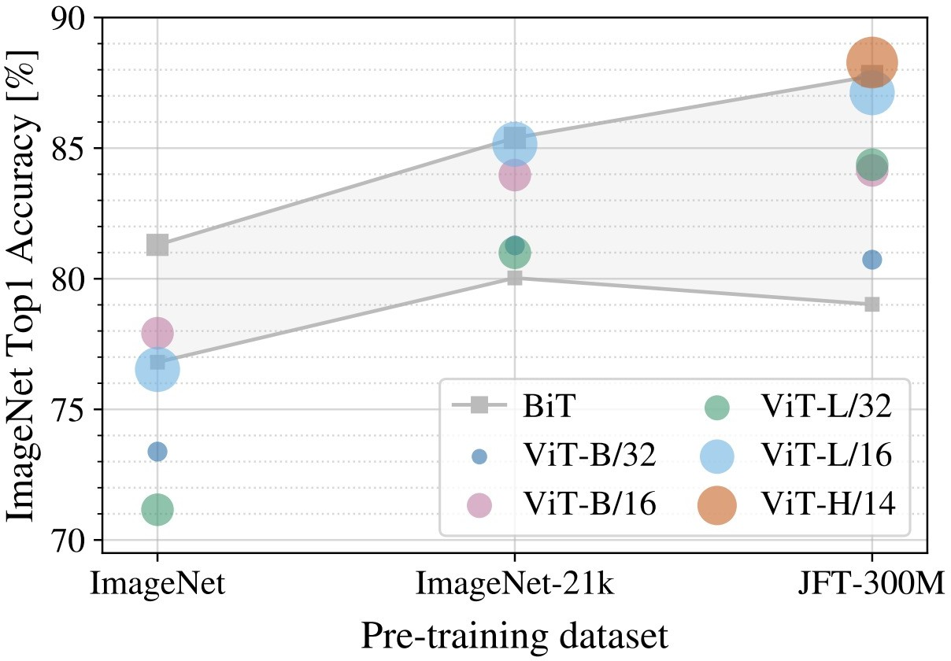
Vision Transformer (ViT) vs ResNets
ResNet-152x4
B = Base L = Large H = Huge
BiT = ResNet152x4
/32, /16, /14 is patch size; smaller patch size is a bigger model (more patches)
Dosovitskiy et al, “An Image is Worth 16x16 Words: Transformers for Image Recognition at Scale”, ICLR 2021
Notes:
Comparison of ViT and ResNets:
Performance Metric:
The y-axis represents the ImageNet Top-1 accuracy percentage, which is a common metric for evaluating the performance of image classification models.
Pre-training Datasets:
The x-axis shows different pre-training datasets: ImageNet, ImageNet-21k, and JFT-300M.
These datasets vary in size and diversity, which can significantly impact the performance of models pre-trained on them.
Model Configurations:
The slide mentions different configurations of Vision Transformers, denoted by B (Base), L (Large), and H (Huge), which refer to the size of the model.
The numbers /32, /16, /14 indicate the patch size used in the ViT models. Smaller patch sizes result in more patches and typically require larger models to process them effectively.
ResNet Baseline:
The ResNet-152x4 model is used as a baseline for comparison. ResNets are a well-established architecture in computer vision, known for their strong performance on image classification tasks.
Key Observations:
The slide is likely intended to show how ViT models perform relative to ResNets across different datasets and configurations.
Larger datasets and more complex model configurations (e.g., smaller patch sizes) are expected to improve the performance of ViT models.
Key Insight:
Vision Transformers can achieve competitive or superior performance compared to traditional convolutional neural networks like ResNets, especially when pre-trained on large and diverse datasets.
The flexibility of ViT in handling different patch sizes and model configurations allows it to adapt to various image recognition tasks effectively.
Benefits of Vision Transformers:
They offer a novel approach to image recognition by leveraging the transformer architecture, which excels at capturing long-range dependencies and interactions.
ViT models can scale with larger datasets and more complex configurations, potentially surpassing the performance of traditional CNNs.

Slide 50
Vision Transformer (ViT) vs ResNets
Recall: ImageNet dataset has 1k categories, 1.2M images
B = Base L = Large H = Huge
When trained on ImageNet, ViT models perform worse than ResNets
BiT = ResNet152x4
ResNets
/32, /16, /14 is patch size; smaller patch size is a bigger model (more patches)
Dosovitskiy et al, “An Image is Worth 16x16 Words: Transformers for Image Recognition at Scale”, ICLR 2021

Slide 51
Vision Transformer (ViT) vs ResNets
ImageNet-21k has 14M images with 21k categories
B = Base L = Large H = Huge
If you pretrain on ImageNet-21k and fine-tune on ImageNet, ViT does better: big ViTs match big ResNets
ResNets
/32, /16, /14 is patch size; smaller patch size is a bigger model (more patches)
Dosovitskiy et al, “An Image is Worth 16x16 Words: Transformers for Image Recognition at Scale”, ICLR 2021

Slide 52
Vision Transformer (ViT) vs ResNets
JFT-300M is an internal Google dataset with 300M labeled images
B = Base L = Large H = Huge
If you pretrain on JFT and finetune on ImageNet, large ViTs outperform large ResNets
ResNets
/32, /16, /14 is patch size; smaller patch size is a bigger model (more patches)
Dosovitskiy et al, “An Image is Worth 16x16 Words: Transformers for Image Recognition at Scale”, ICLR 2021

Slide 53
Vision Transformer (ViT) vs ResNets
ViT: 2.5k TPU-v3 core days of training
JFT-300M is an internal Google dataset with 300M labeled images
ResNet: 9.9k TPU-v3 core days of training
If you pretrain on JFT and finetune on ImageNet, large ViTs outperform large ResNets
ViTs make more efficient use of GPU
/ TPU hardware (matrix multiply is more hardware-
friendly than conv)
ResNets
Dosovitskiy et al, “An Image is Worth 16x16 Words: Transformers for Image Recognition at Scale”, ICLR 2021

Slide 54
Vision Transformer (ViT) vs ResNets
ViT: 2.5k TPU-v3 core days of training
Claim: ViT models have “less inductive bias” than ResNets, so need more pretraining data to learn good features
ResNet: 9.9k TPU-v3 core days of training
ViTs make more efficient use of GPU
/ TPU hardware (matrix multiply is more hardware-
friendly than conv)
(Not sure I buy this explanation: “inductive bias” is not a well- defined concept we can measure!)
ResNets
Dosovitskiy et al, “An Image is Worth 16x16 Words: Transformers for Image Recognition at Scale”, ICLR 2021

Slide 55
Vision Transformer (ViT) vs ResNets
ViT: 2.5k TPU-v3 core days of training
ResNet: 9.9k TPU-v3 core days of training
How can we improve the performance of ViT models on ImageNet?
ViTs make more efficient use of GPU
/ TPU hardware (matrix multiply is more hardware-
friendly than conv)
ResNets
Dosovitskiy et al, “An Image is Worth 16x16 Words: Transformers for Image Recognition at Scale”, ICLR 2021
Notes:
Performance Comparison:
Accuracy Metric:
The y-axis represents the ImageNet Top-1 accuracy percentage, a standard metric for evaluating image classification models.
Pre-training Datasets:
The x-axis shows different pre-training datasets: ImageNet, ImageNet-21k, and JFT-300M.
These datasets vary in size and diversity, impacting the performance of models pre-trained on them.
Model Configurations:
The slide compares different configurations of Vision Transformers (ViT-B/32, ViT-B/16, ViT-L/32, ViT-L/16, ViT-H/14) and ResNets.
The numbers /32, /16, /14 indicate the patch size used in the ViT models. Smaller patch sizes result in more patches and typically require larger models to process them effectively.
Training Efficiency:
ViT models are noted for their efficient use of GPU/TPU hardware, with matrix multiplication being more hardware-friendly than convolution operations.
ViT models require 2.5k TPU-v3 core days of training, compared to 9.9k TPU-v3 core days for ResNets, indicating a significant reduction in computational resources.
Key Observations:
ViT models show competitive or superior performance compared to ResNets, especially when pre-trained on larger datasets like JFT-300M.
The efficiency of ViT models in utilizing hardware resources makes them attractive for large-scale image recognition tasks.
Key Insight:
Vision Transformers can achieve high accuracy with efficient training, making them a powerful alternative to traditional convolutional neural networks like ResNets.
The ability to leverage large datasets and efficient hardware utilization positions ViT models as a promising approach for advancing image recognition technology.
Benefits of Vision Transformers:
They offer a novel approach to image recognition by leveraging the transformer architecture, which excels at capturing long-range dependencies and interactions.
ViT models can scale with larger datasets and more complex configurations, potentially surpassing the performance of traditional CNNs.
Considerations for Improvement:
The slide poses a question about improving ViT performance on ImageNet, suggesting that further research and optimization could enhance their effectiveness on this benchmark.
This slide provides insights into the performance and efficiency of Vision Transformers compared to ResNets, highlighting the potential of ViT models to advance the state of the art in computer vision. Understanding these comparisons is crucial for appreciating the advantages of ViT models in terms of accuracy and computational efficiency.

Slide 56
Additional Readings:
[Recommended] An Image is Worth 16x16 Words: Transformers for Image Recognition at Scale - Alexey Dosovitskiy, …… 2020, CVPR
https://web.stanford.edu/~jurafsky/slp3/ Ch 9 and 10
https://colab.research.google.com/drive/1P9TPRWsDdqJC6IvOxjG2_3QlgCt59P0w?usp=sharing#scrollTo=KVVWmPso4eGf

Slide 57
Thank you

